Slide 1
Topic06.Data Visualization
資料科學 Data Science
張家銘 Jia-Ming Chang
政治大學資訊科學系
The slide isonly for educational purposes. If any infringement, please contact me and we will correct immediately.

Slide 2
Copyright declaration 版權說明
Some of the figures in this presentation are taken from "An Introduction to Statistical Learning, with applications in R" (Springer, 2013) with permission from the authors: G. James, D. Witten, T. Hastie and R. Tibshirani.
The web site of the book
The credit of individual is indicated in the bottom part of the slide.
ie.,

Slide 3
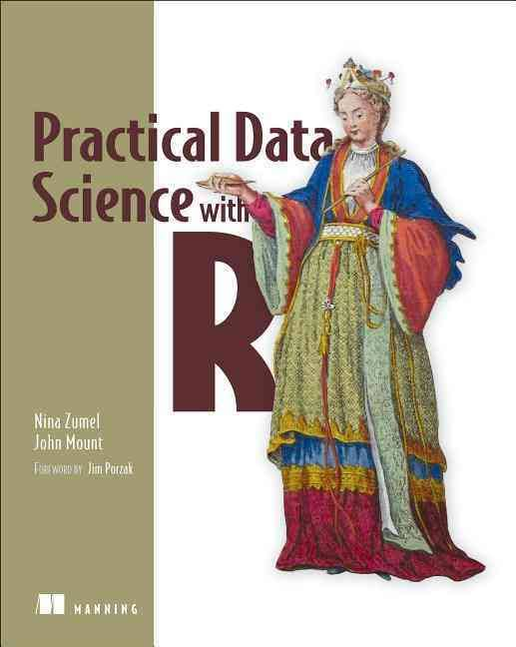
Copyright declaration 版權說明
Some of the figures in this presentation are taken from "Practical Data Science with R (Manning, 2019)”
The web site of the book
The credit of individual is indicated in the bottom part of the slide.
ie.,

Slide 4
Copyright declaration 版權說明
Some of the figures in this presentation are taken from "R for Data Science” under the Creative Commons Attribution-NonCommercial-NoDerivs 3.0 License.
The web site of the book
The credit of individual is indicated in the bottom part.
ie.,

Slide 5
Data Science this week
Elon Musk’s OpenAI Unveils a Simpler Way for Machines to Learn
The group says it has a more practical way to get software to learn tasks, such as steering robots, that require multiple actions.
by Tom Simonite March 27, 2017
https://goo.gl/LhEX3X
https://openai.com/

Slide 6
Recap for the last week

Slide 7
Sampling for modeling and validation
train/calibration, test
Splitting into test and training using a random group mark
custdata$gp <- runif(dim(custdata)[1])
testSet <- subset(custdata, custdata$gp <= 0.1)
trainingSet <- subset(custdata, custdata$gp > 0.1)
Practical Data Science with R by Nina Zumel, John Mount

Slide 8
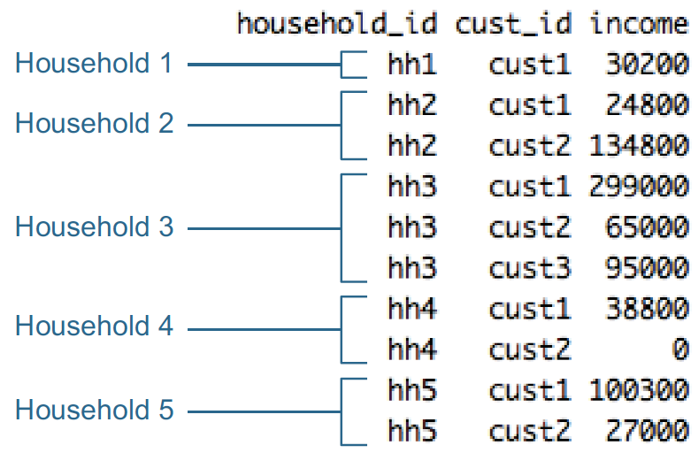
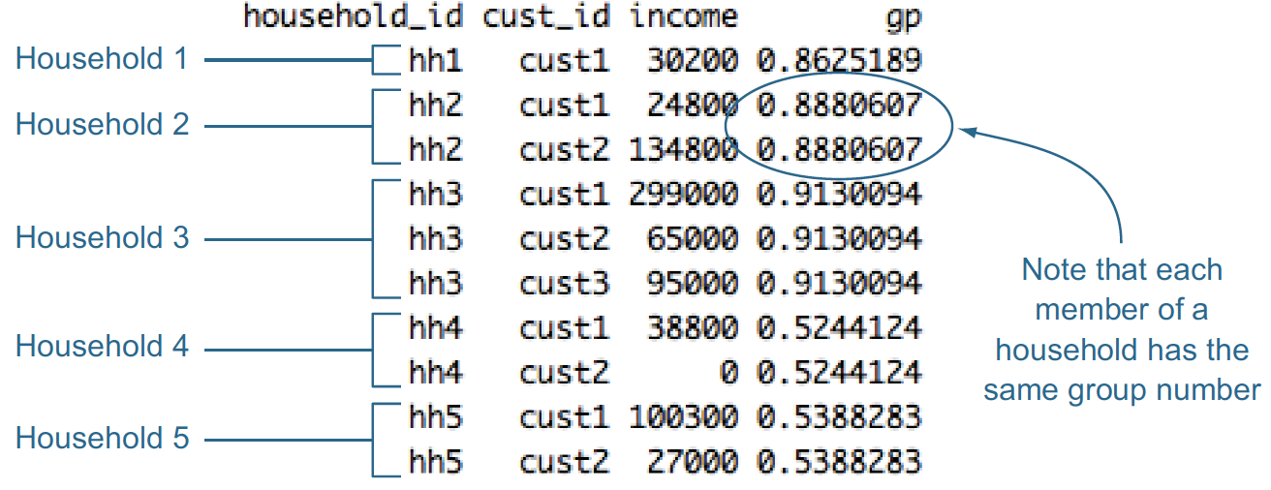
Record grouping
hh <- unique(hhdata$household_id)
households <- data.frame(household_id = hh, gp = runif(length(hh)))
hhdata <- merge(hhdata, households, by="household_id")
Figure4.7, Practical Data Science with R by Nina Zumel, John Mount

Slide 9
Outline
Tips in data visualization
How to make a good Table?
ggplot2
Box Plot
Scatter Plots
Bar chart
Interactive visualization
Shiny app

Slide 10
Tips in data visualization

Slide 11
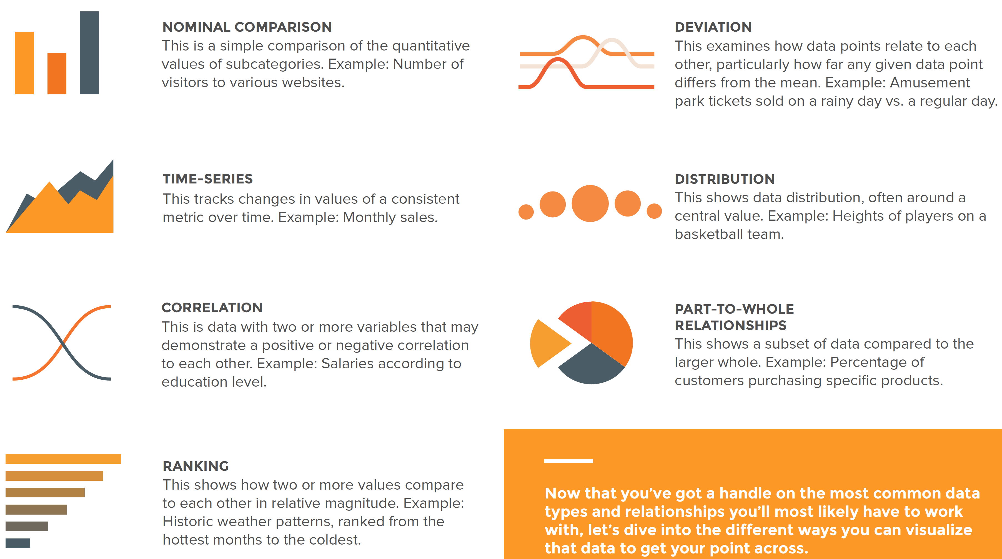
Data Relationships
Credit by Data Visualization 101: How To Design Charts and Graphs, HubSpot and Visage

Slide 12
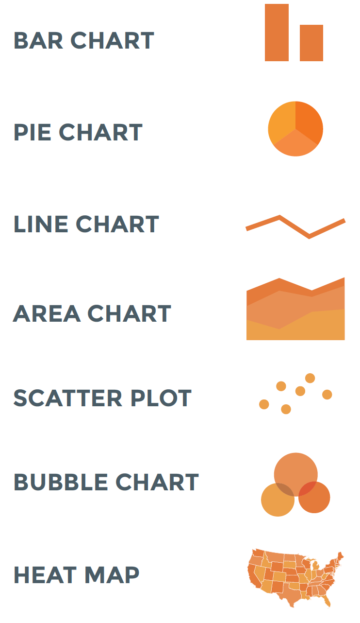
Guide to chart types
Credit by https://visage.co/data-visualization-101-pie-charts/

Slide 13
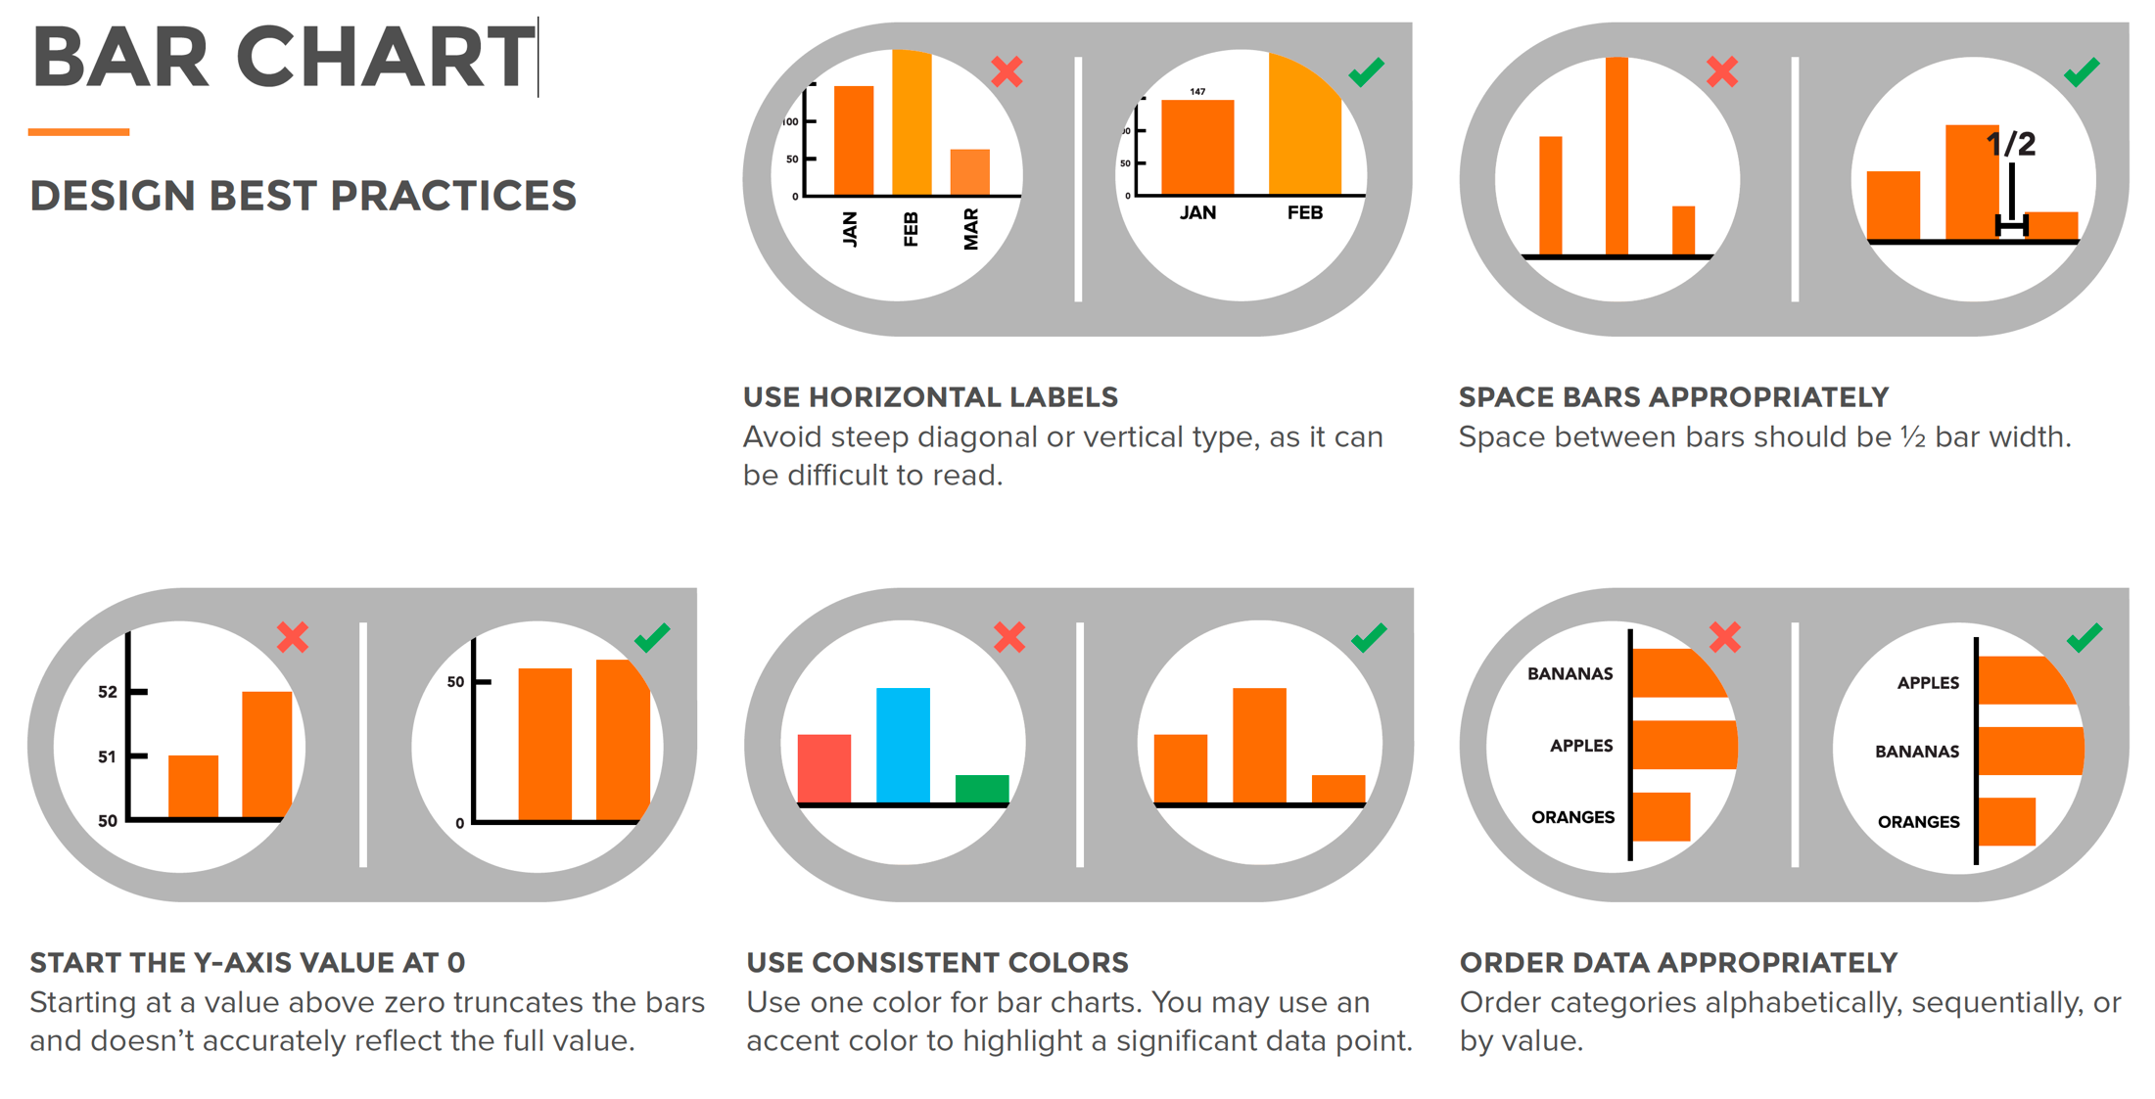
Credit by https://visage.co/data-visualization-101-bar-charts/

Slide 14
Pie Chart
piechart.R
slices <- c(10, 12, 4, 16, 8)
lbls <- c("US", "UK", "Australia", "Germany", "France") pct <- round(slices/sum(slices)*100) lbls <- paste(lbls, pct) # add percents to labels
lbls <- paste(lbls,"%",sep="") # ad % to labels
pie(slices,labels = lbls, main="Pie Chart of Countries")

Slide 15
Data visualization
Grading1
Homework 60%
Midterm 15%
Final Project 25%
Grading2
Homework 70%
Midterm 10%
Final project 20%

Slide 16
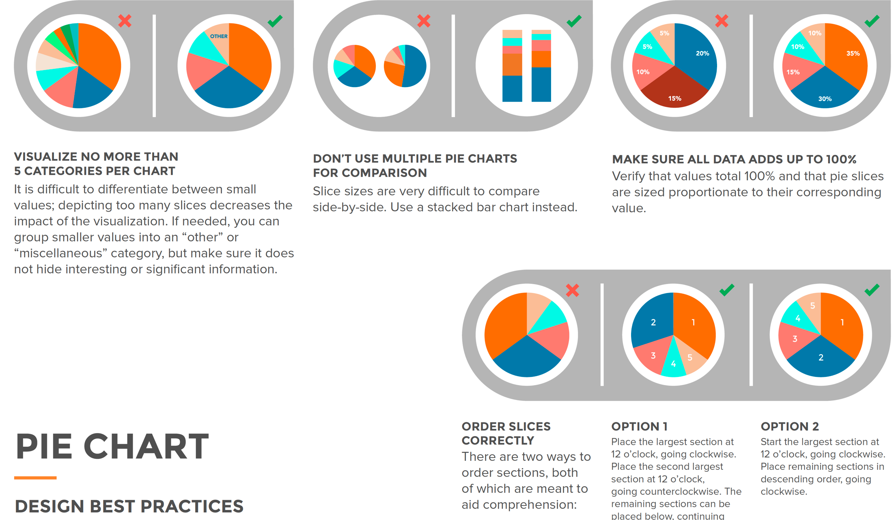
Credit by Data Visualization 101: How To Design Charts and Graphs, HubSpot and Visage

Slide 17
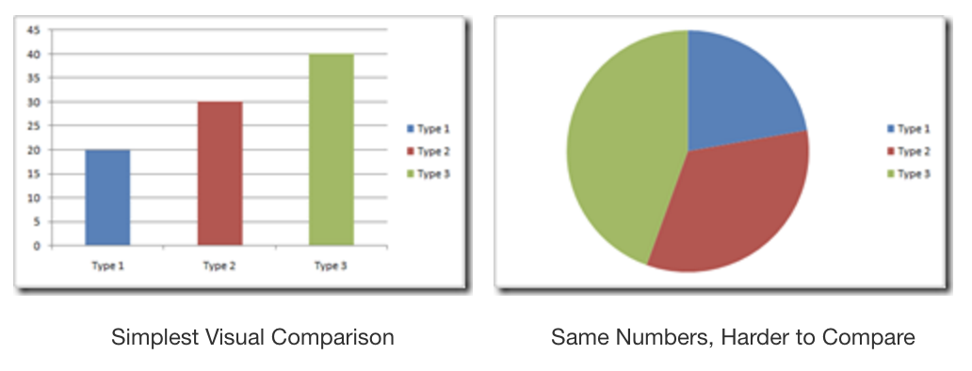
Pie Chart vs Bar Chart
Visualize no more than 5 categories per chart.
Credit by http://www.powerpivotpro.com/2009/12/the-death-of-pie-charts/

Slide 18
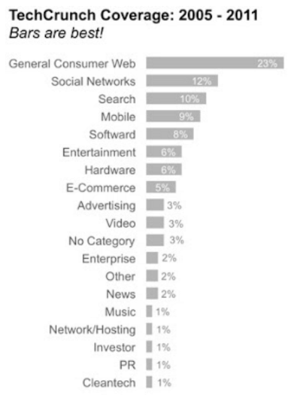
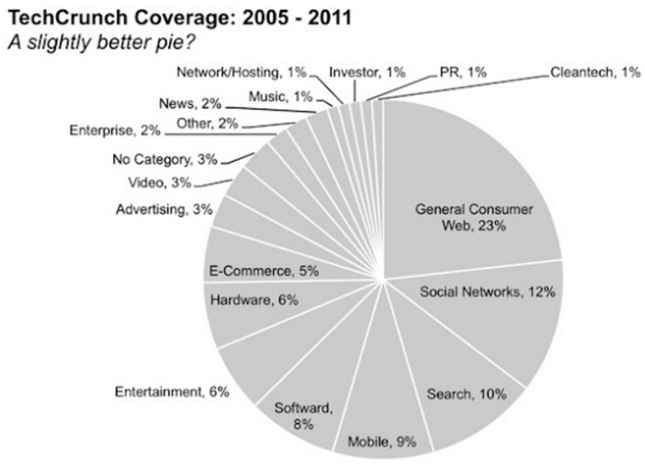
Pie Chart vs Bar Chart
Visualize no more than 5 categories per chart.
http://www.storytellingwithdata.com/blog/2011/07/death-to-pie-charts

Slide 19
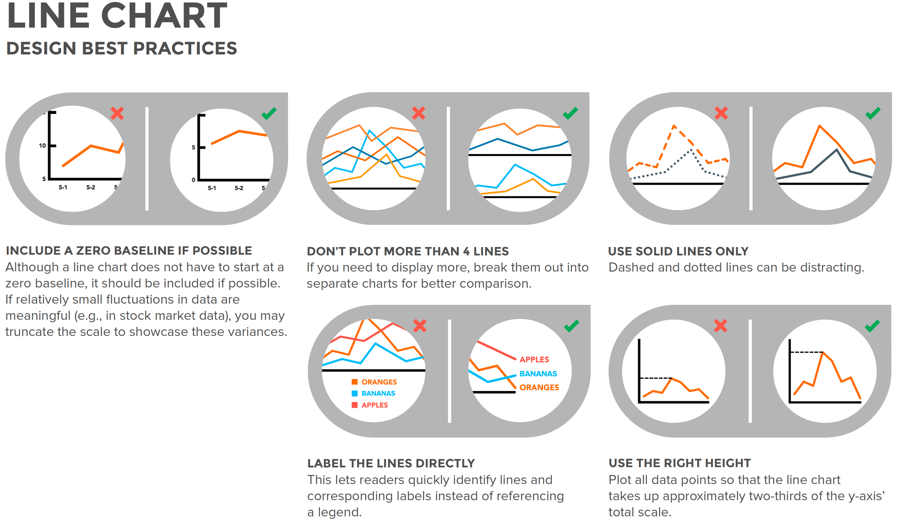

Credit by Data Visualization 101: How To Design Charts and Graphs, HubSpot and Visage

Slide 20
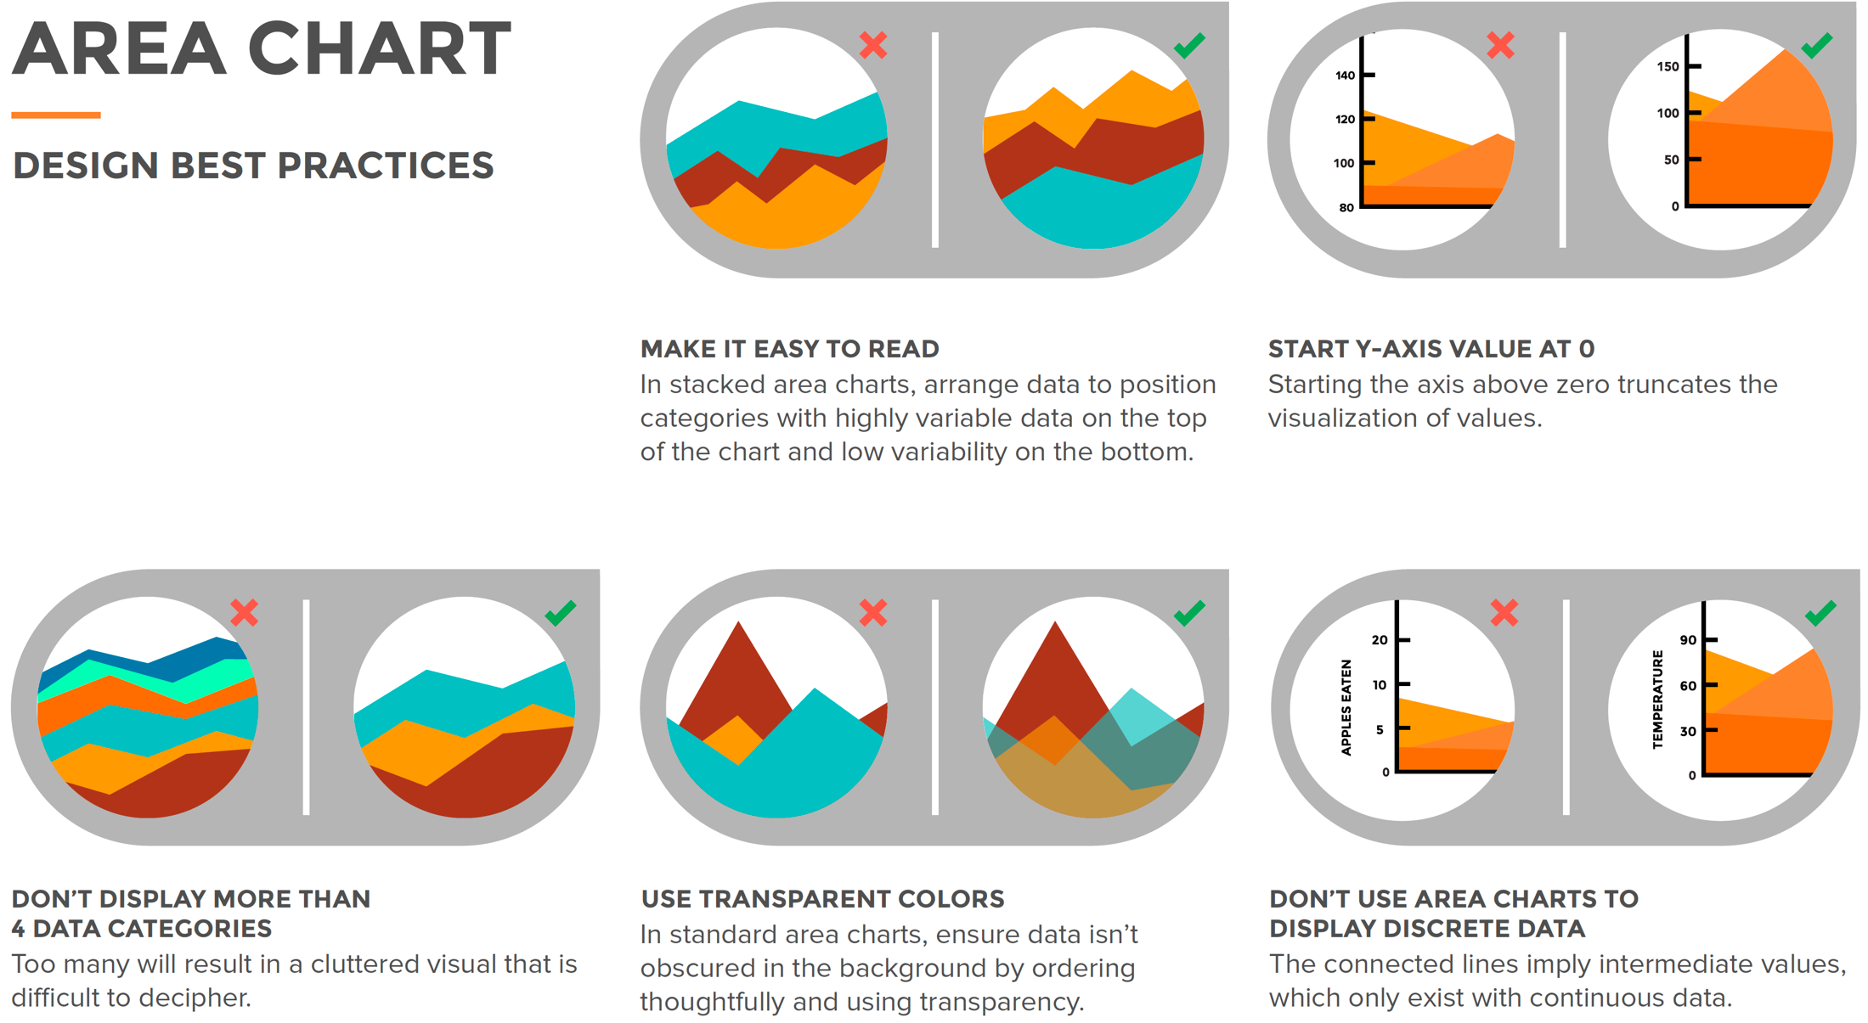
Credit by Data Visualization 101: How To Design Charts and Graphs, HubSpot and Visage

Slide 21
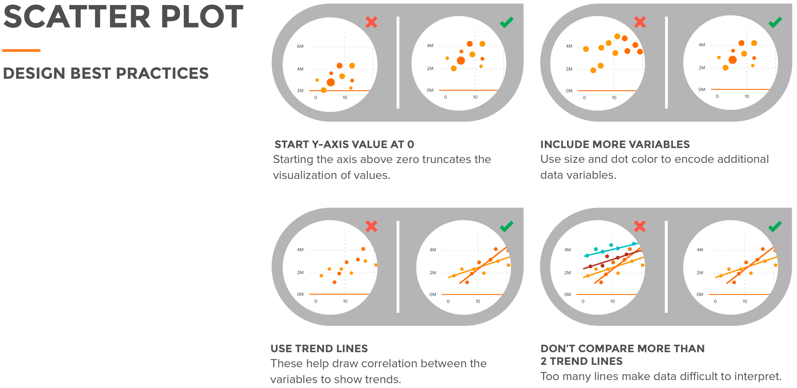
Credit by Data Visualization 101: How To Design Charts and Graphs, HubSpot and Visage

Slide 22
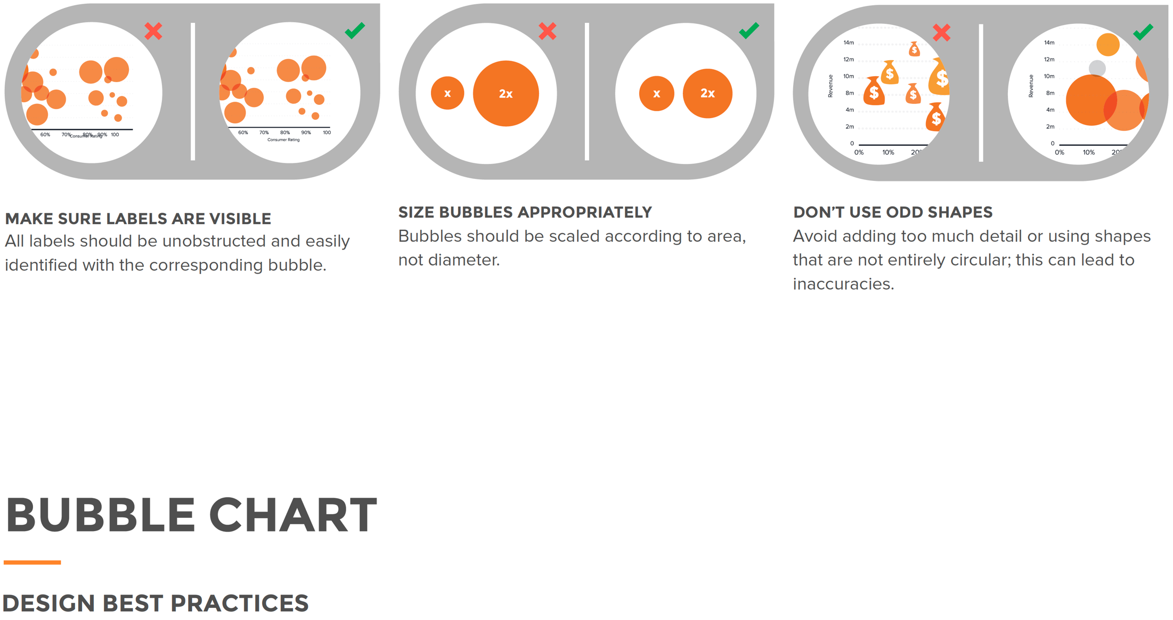
Credit by Data Visualization 101: How To Design Charts and Graphs, HubSpot and Visage

Slide 23
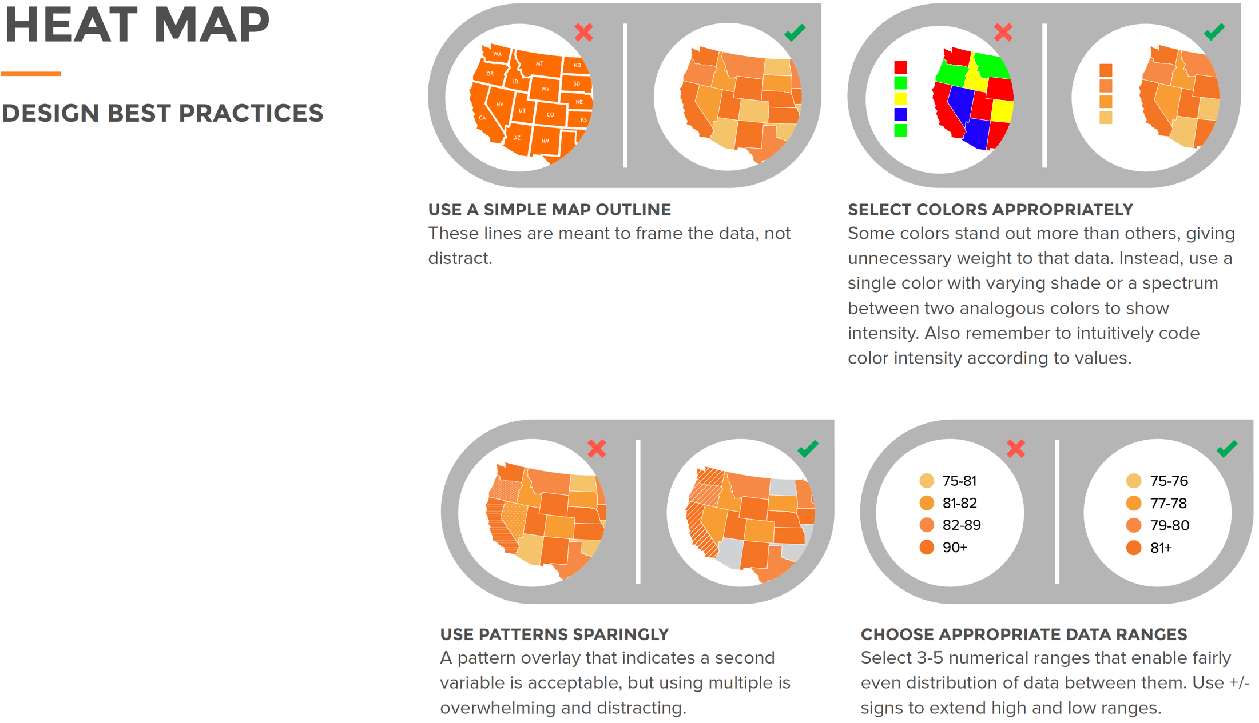
Credit by Data Visualization 101: How To Design Charts and Graphs, HubSpot and Visage

Slide 24
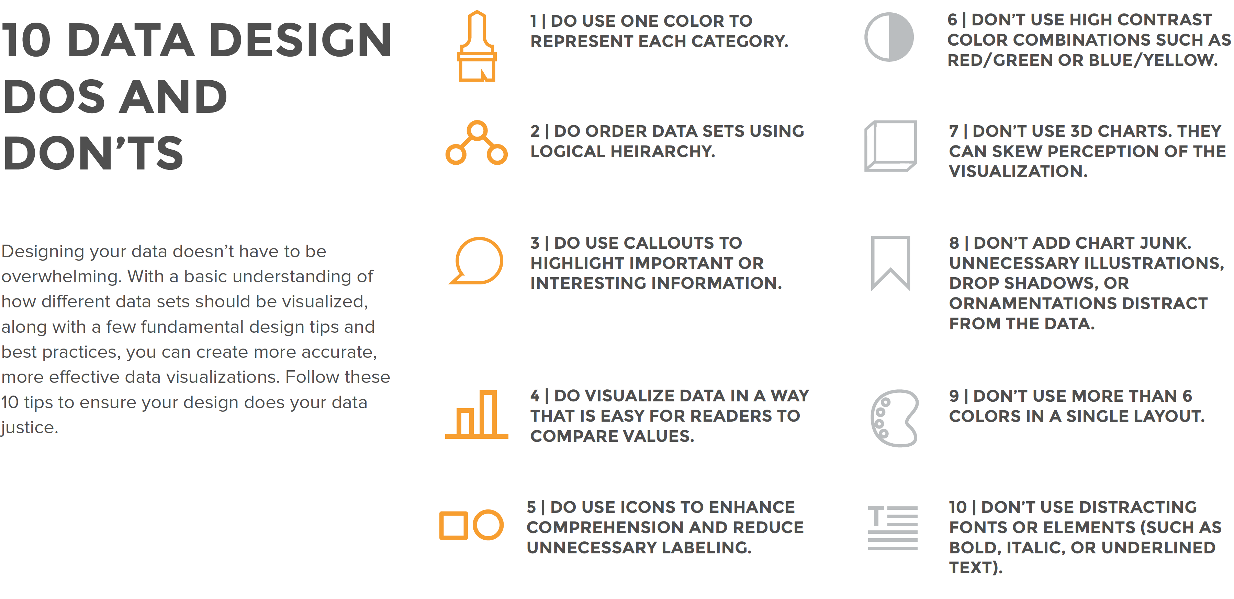
Credit by Data Visualization 101: How To Design Charts and Graphs, HubSpot and Visage

Slide 25
How to make a good Table?
Credit by Jia-Bin Huang, https://twitter.com/jbhuang0604/status/1626372613441290240

Slide 26
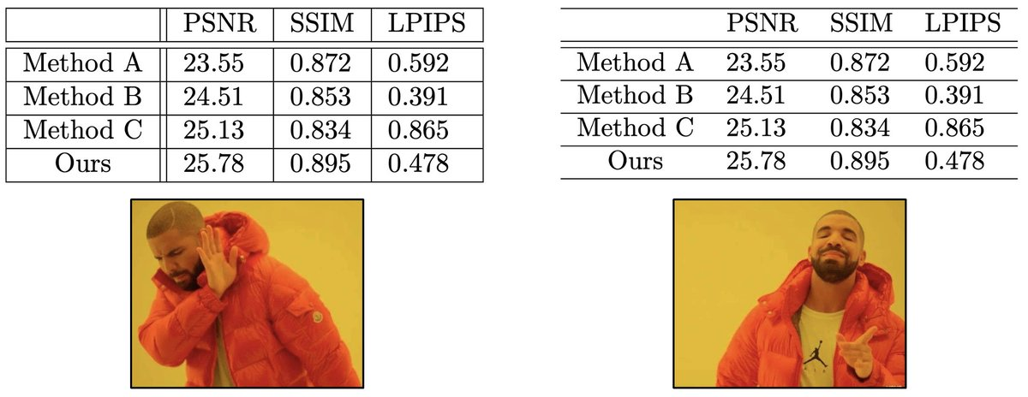
Avoid vertical lines
Having vertical lines in a table almost always makes the table less readable.
Credit by Jia-Bin Huang, https://twitter.com/jbhuang0604/status/1626372613441290240

Slide 27
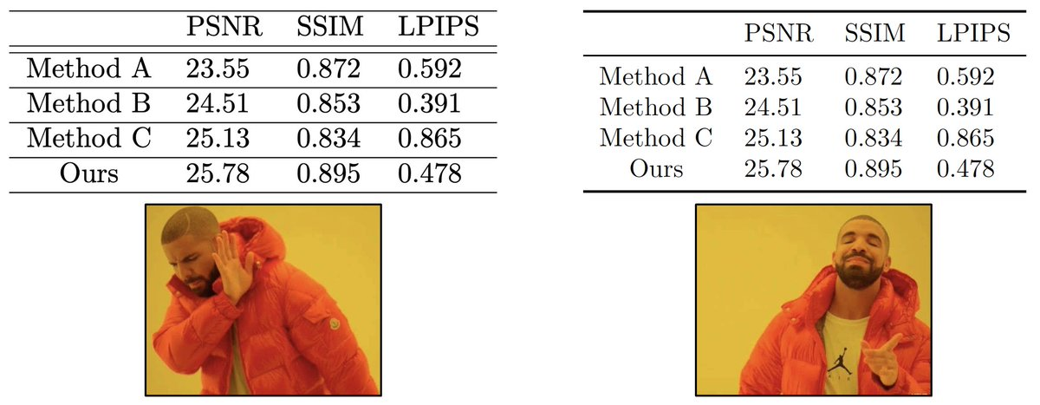
Never, ever use double rules
Feel the urge to use double rules (\hline)?
Credit by Jia-Bin Huang, https://twitter.com/jbhuang0604/status/1626372613441290240

Slide 28
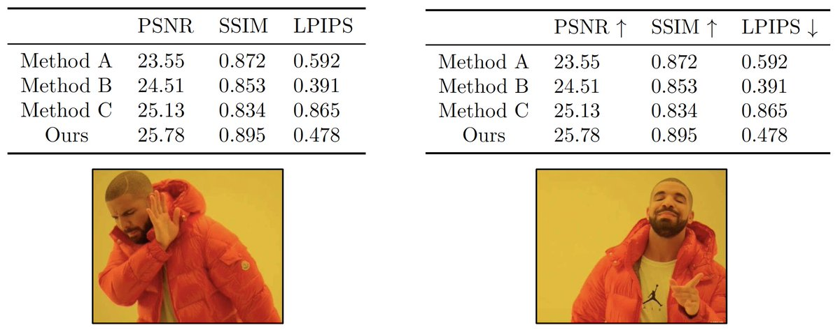
Label the columns
Add up/down arrows to let readers know how to interpret the numbers.
Add units to let your readers understand what the numbers mean.
Credit by Jia-Bin Huang, https://twitter.com/jbhuang0604/status/1626372613441290240

Slide 29
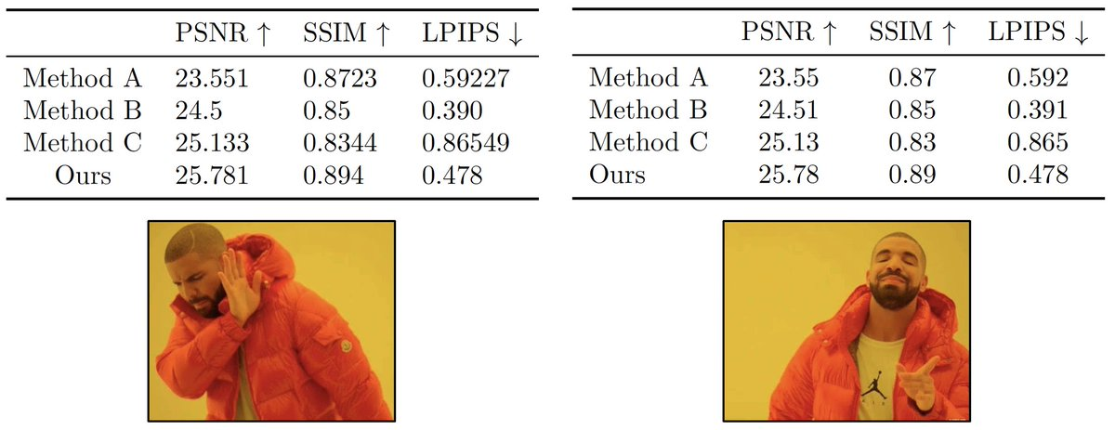
Align everything
Align texts to the left
Align numbers to the center
Align numbers at consistent decimal point
Credit by Jia-Bin Huang, https://twitter.com/jbhuang0604/status/1626372613441290240

Slide 30
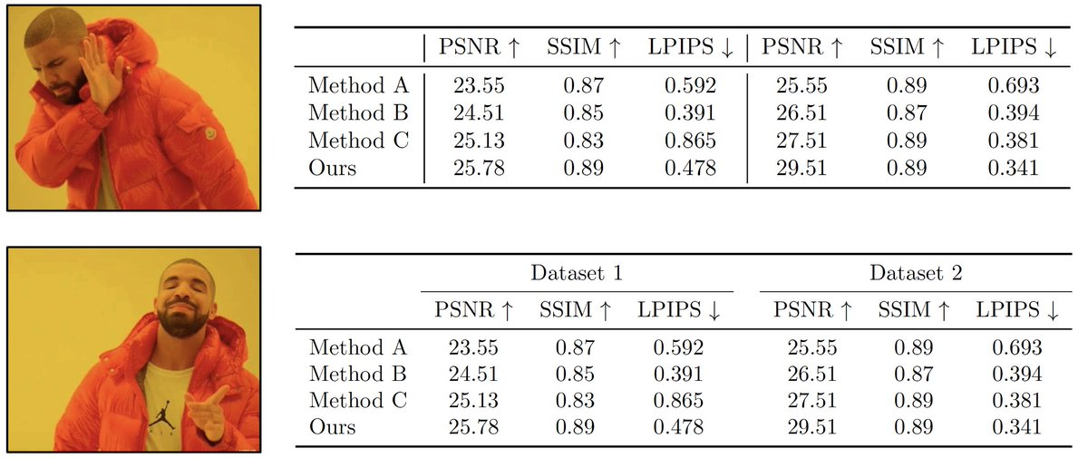
Grouping results
Have two or more groups of results and feel the urge again to separate them using vertical lines?
\multicolumn comes to the rescue!
Remember to use \cmidrule to group the right columns!
Credit by Jia-Bin Huang, https://twitter.com/jbhuang0604/status/1626372613441290240

Slide 31
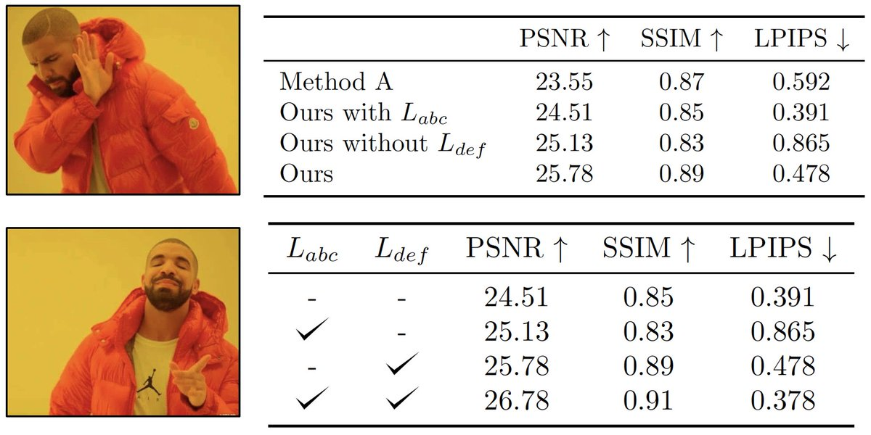
Encode rows with attributes
One table, one message. Don't mix all the results together.
If possible, encode different rows using *attributes* so that it's easy for readers to understand/compare results from different rows.
Credit by Jia-Bin Huang, https://twitter.com/jbhuang0604/status/1626372613441290240

Slide 32
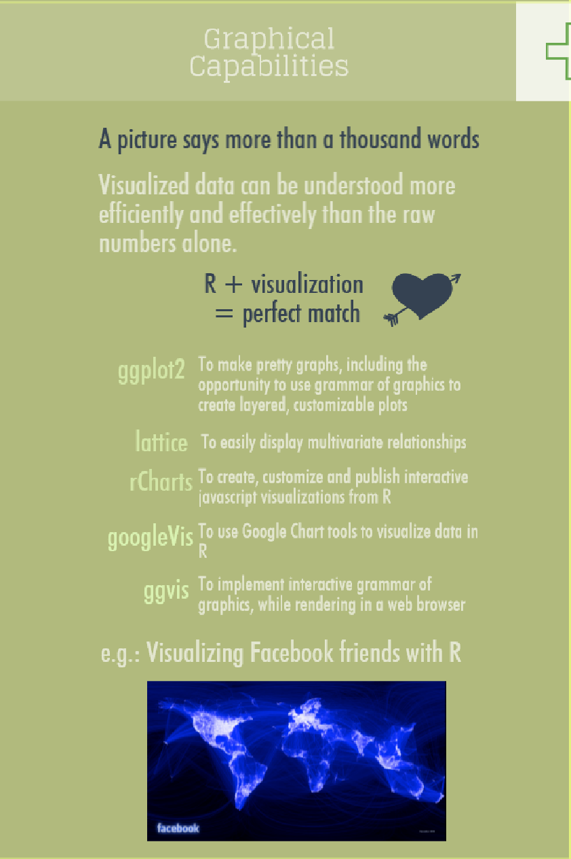
Credit by https://www.datacamp.com/community/tutorials/r-or-python-for-data-analysis

Slide 33
ggplot2

Slide 34
ggplot2
http://ggplot2.org/
one of the best static visualization packages in R
a plotting system for R, based on the grammar of graphics, which tries to take the good parts of base and lattice graphics and none of the bad parts. It takes care of many of the fiddly details that make plotting a hassle (like drawing legends) as well as providing a powerful model of graphics that makes it easy to produce complex multi-layered graphics.

Slide 35
ggplot2 call
ggplot.R
Which one will you use?
ggplot(data = faithful, mapping = aes(x = eruptions)) + geom_freqpoly(binwidth = 0.25)
ggplot(faithful, aes(eruptions)) + geom_freqpoly(binwidth = 0.25)
R for Data Science by Garrett Grolemund, Hadley Wickham

Slide 36
Box plot
McGill, R., Tukey, J. W. and Larsen, W. A. (1978). Variations of box plots. The American Statistician, 32, 12–16. doi:10.2307/2683468.

Slide 37
Boxplot
R for Data Science by Garrett Grolemund, Hadley Wickham

Slide 38
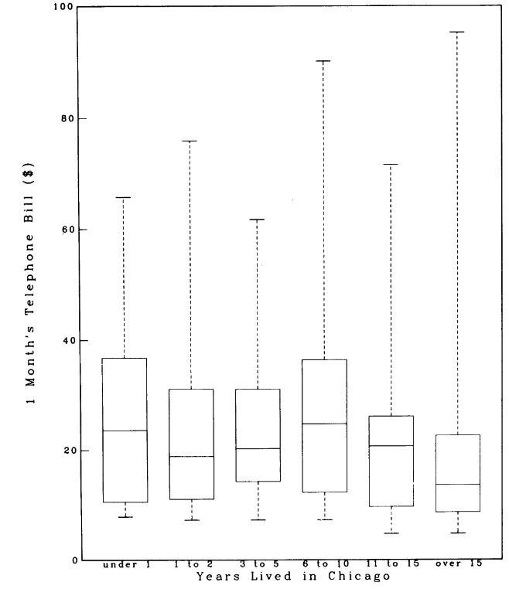
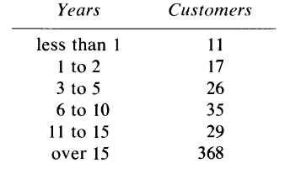
Regular box plot
Telephone bill vs Years lived in Chicago
Credit by Mcgill, R., Tukey, J. W. & Larsen, W. A. Variations of Box Plots. Am. Stat. 32, 12–16 (1978).

Slide 39
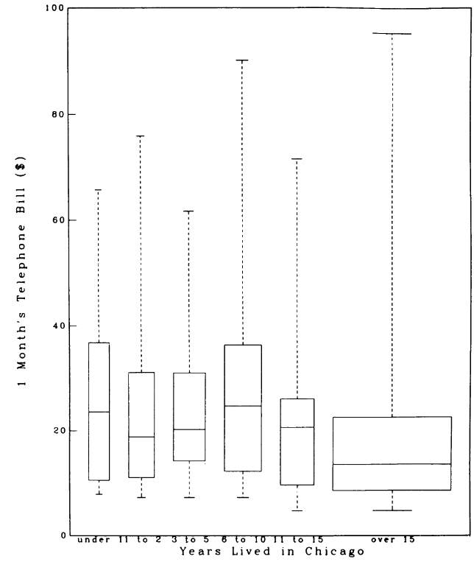
Variable-width box plots
widths of the boxes ~ the square root of the group size.
many variability measures, such as standard error, are proportional to the root of the group size.
use of a logit scale is sometimes preferred
Telephone bill vs Years lived in Chicago
Telephone bill vs Years lived in Chicago
Width of box ~ root group size
Credit by Mcgill, R., Tukey, J. W. & Larsen, W. A. Variations of Box Plots. Am. Stat. 32, 12–16 (1978).

Slide 40
Notch

Slide 41
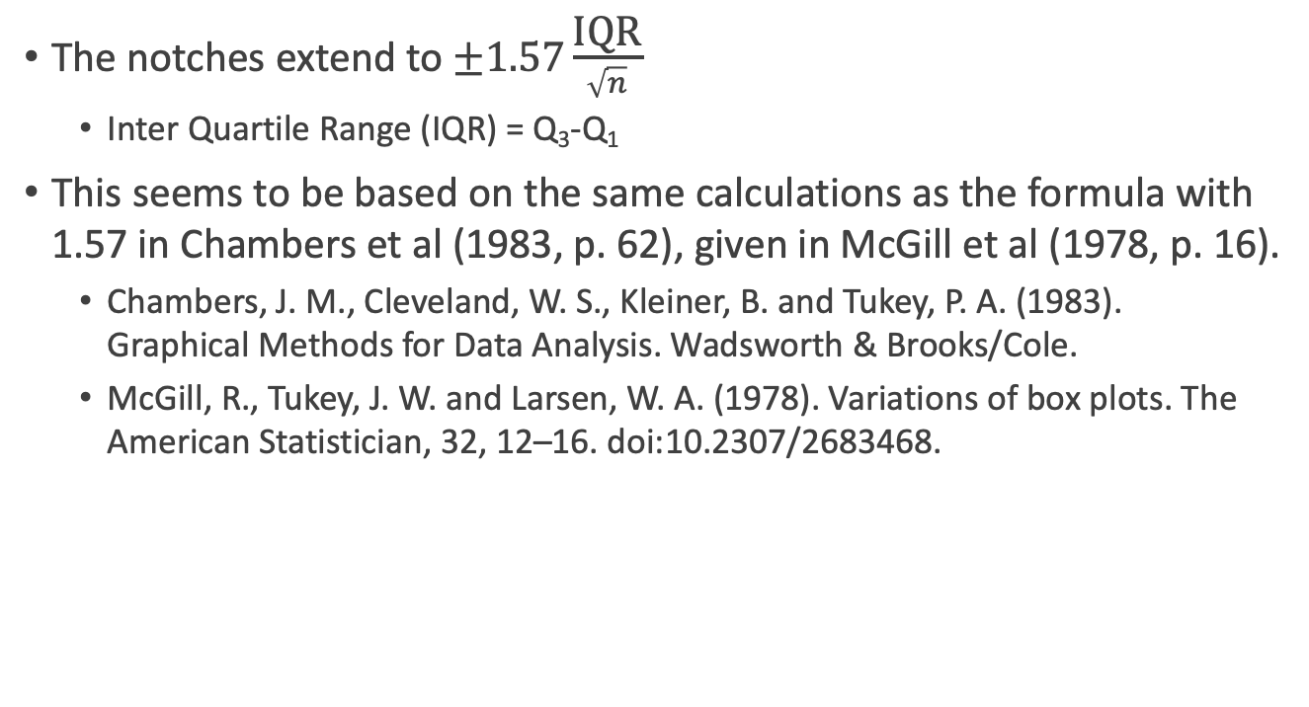
Notched box by notch = T
The notches extend to $±1.57\frac{\text{IQR}}{\sqrt{n}}$
Inter Quartile Range (IQR) = Q₃-Q₁
This seems to be based on the same calculations as the formula with 1.57 in Chambers et al (1983, p. 62), given in McGill et al (1978, p. 16).
Chambers, J. M., Cleveland, W. S., Kleiner, B. and Tukey, P. A. (1983). Graphical Methods for Data Analysis. Wadsworth & Brooks/Cole.
McGill, R., Tukey, J. W. and Larsen, W. A. (1978). Variations of box plots. The American Statistician, 32, 12–16. doi:10.2307/2683468.

Slide 42

Why $±1.57\frac{\text{IQR}}{\sqrt{n}}$ ?
They are based on asymptotic normality of the median and roughly equal sample sizes for the two medians being compared, and are said to be rather insensitive to the underlying distributions of the samples. The idea appears to be to give roughly a 95% confidence interval for the difference in two medians.

Slide 43
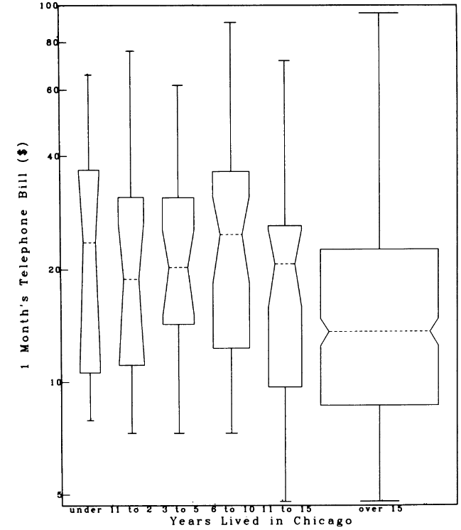
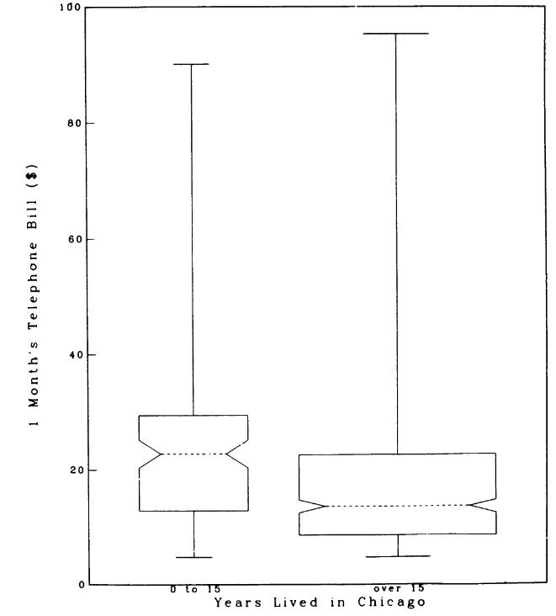
Variable-Width Notched Box Plot
Telephone bill vs Years lived in Chicago
Width of box ~ root group size
Telephone bill vs Years lived in Chicago
Width of box ~ root group size Non-overlapping of notches => sign. Diff. at ~95% level
Telephone bill vs Years lived in Chicago
Width of box ~ root group size Non-overlapping of notches => sign. Diff. at ~95% level
The first 5 groups are combined
Credit by Mcgill, R., Tukey, J. W. & Larsen, W. A. Variations of Box Plots. Am. Stat. 32, 12–16 (1978).
Notes:
a log axis used in Figure 2 & 3

Slide 44
Refine boxplot – order & flip
boxplot.R
ggplot(data = mpg, mapping = aes(x = class, y = hwy)) + geom_boxplot()
What is problem?
ggplot(data = mpg) +
geom_boxplot(mapping = aes(x = reorder(class, hwy, FUN = median), y = hwy))
What is problem?
ggplot(data = mpg) +
geom_boxplot(mapping = aes(x = reorder(class, hwy, FUN = median), y = hwy)) +
coord_flip()
R for Data Science by Garrett Grolemund, Hadley Wickham

Slide 45
Two variables?

Slide 46
Visually checking relationships between two variables
Is there a relationship
between the two inputs age and income in my data?
between the input marital status and the output health?
What kind of relationship, and how strong?
Practical Data Science with R by Nina Zumel, John Mount

Slide 47
Scatter plots
Two numerical variables

Slide 48
Two continuous variables
Relation between carat & price
ggplot(data = diamonds) + geom_point(mapping = aes(x = carat, y = price))
What is problem?
ggplot(data = diamonds) + geom_point(mapping = aes(x = carat, y = price), alpha = 1 / 100)
What is problem?
ggplot(data = diamonds) + geom_bin2d(mapping = aes(x = carat, y = price))
R for Data Science by Garrett Grolemund, Hadley Wickham

Slide 49
Two continuous variables
bin one continuous variable into a categorical variable
ggplot(data = diamonds, mapping = aes(x = carat, y = price)) + geom_boxplot(mapping = aes(group = cut_width(carat, 0.1)))
R for Data Science by Garrett Grolemund, Hadley Wickham

Slide 50
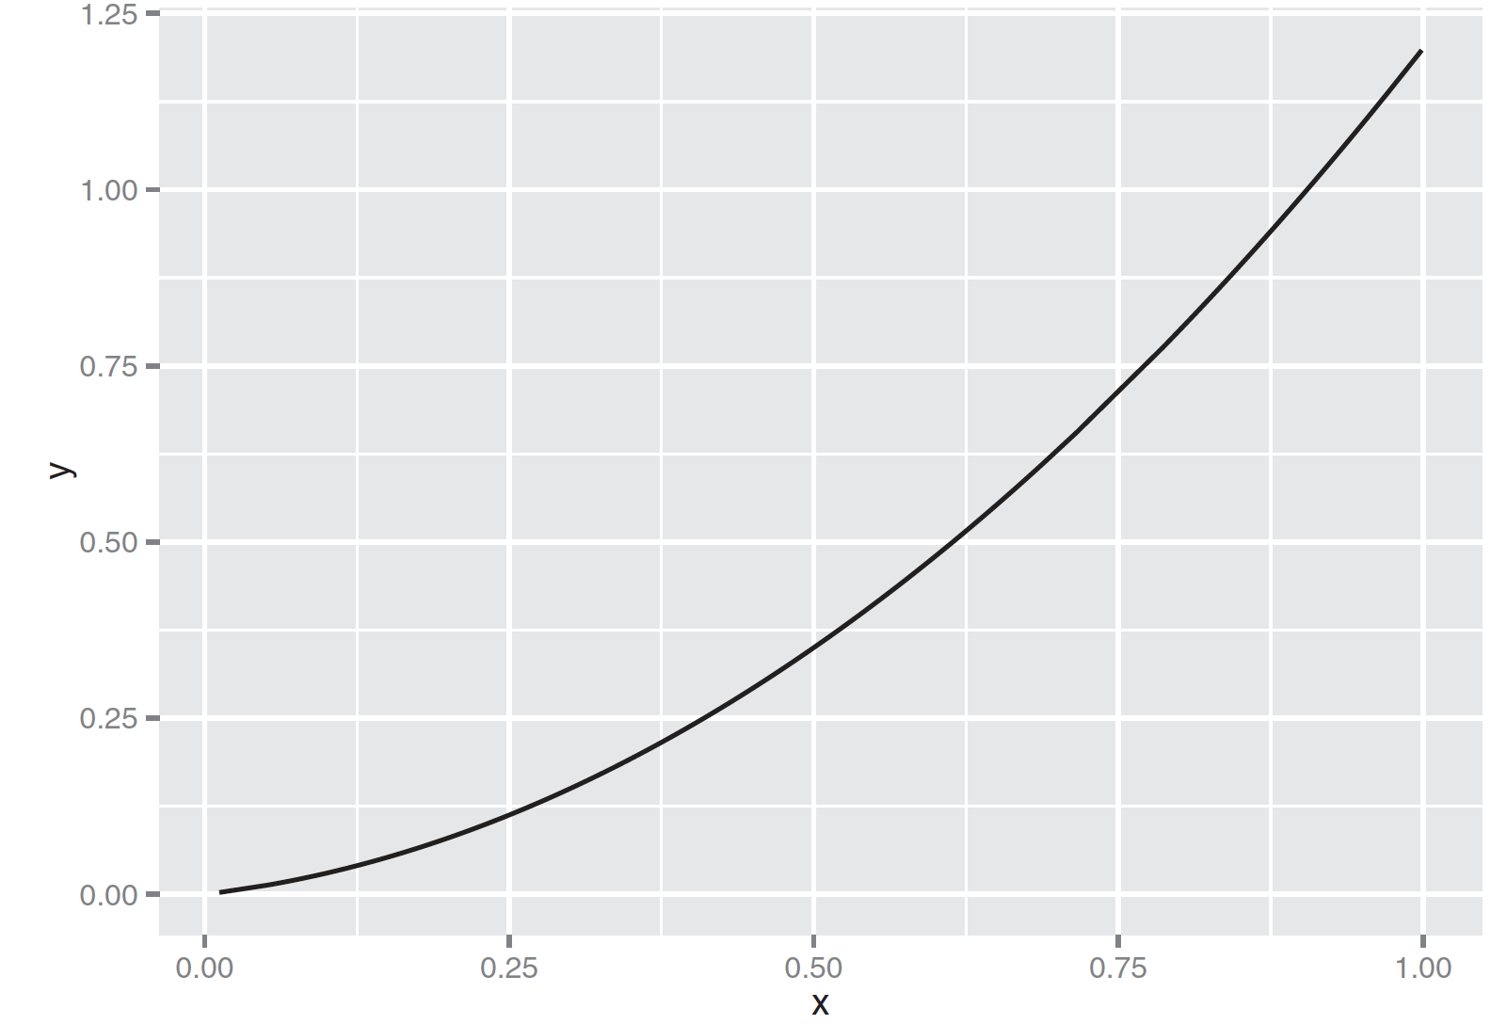
Line Plots
relation.R
x <- runif(100)
y <- x^2 + 0.2*x
ggplot(data.frame(x=x,y=y), aes(x=x,y=y)) + geom_line()
Figure3.9, Practical Data Science with R by Nina Zumel, John Mount

Slide 51
Line Plot does not work
When the data is not so cleanly related, line plots aren’t as useful!
custdata2 <- subset(custdata, (custdata$age > 0 & custdata$age < 100 & custdata$income > 0))
ggplot(custdata2, aes(x=custdata2$age, y=custdata2$income)) + geom_line()
Practical Data Science with R by Nina Zumel, John Mount

Slide 52
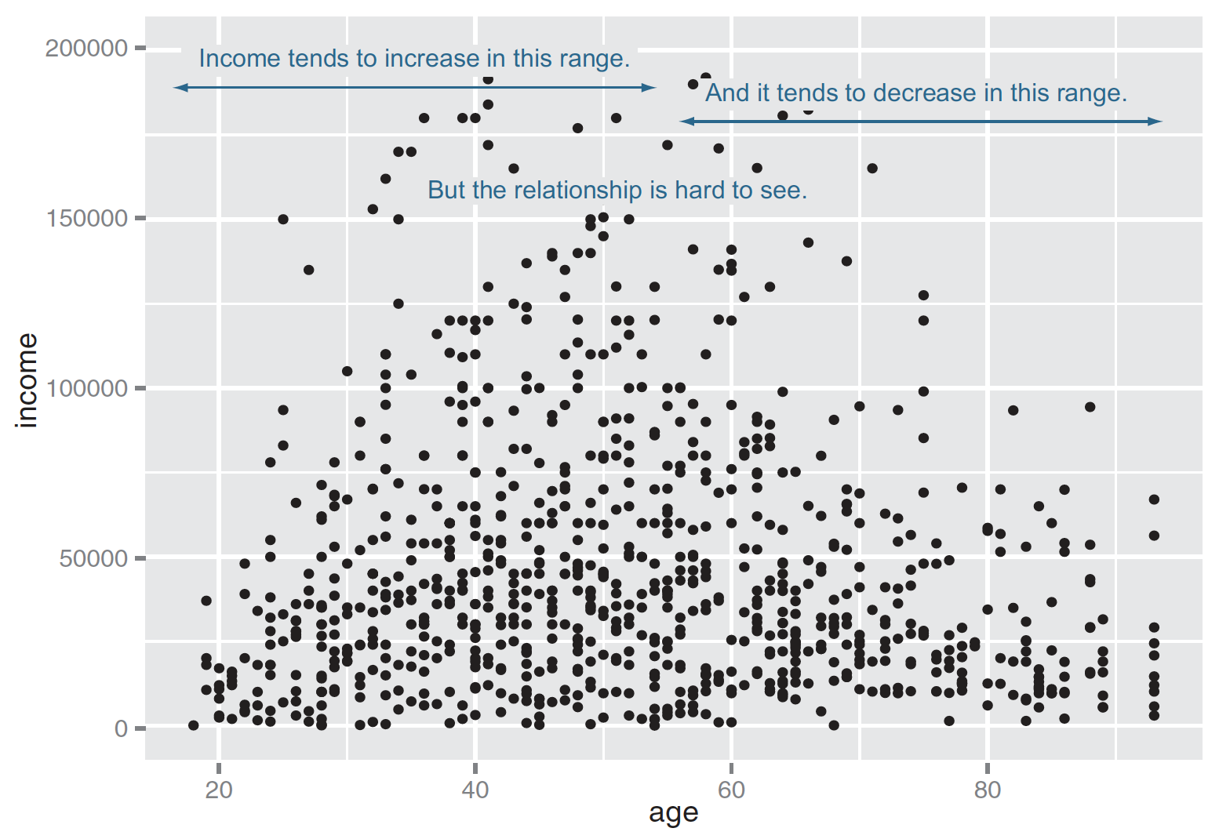
Scatter Plots
ggplot(custdata2, aes(x=age, y=income)) + geom_point() + ylim(0, 200000)
Figure3.10, Practical Data Science with R by Nina Zumel, John Mount

Slide 53
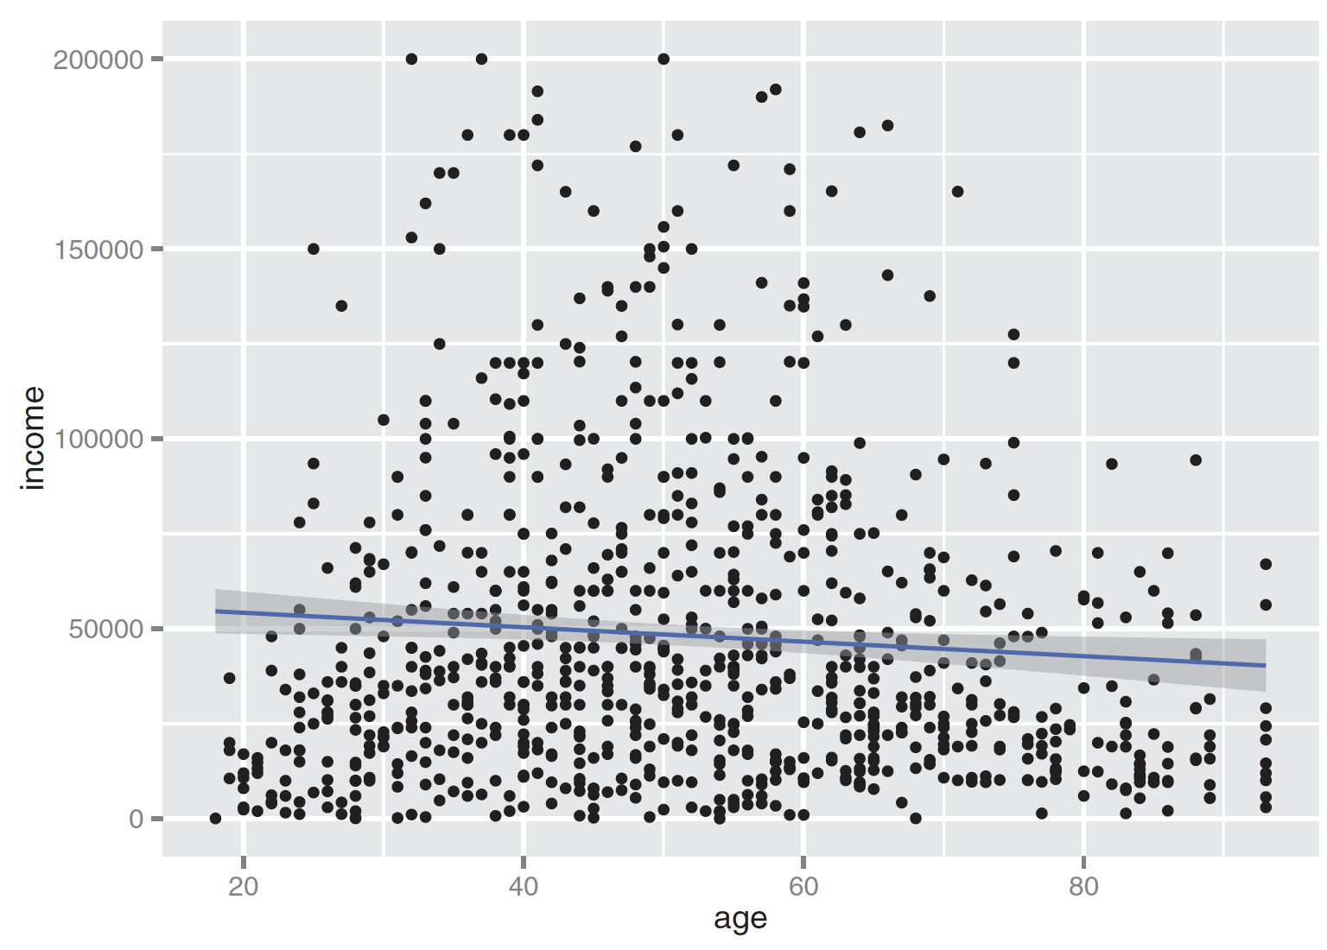
Linear fit
ggplot(custdata2, aes(x=age, y=income)) + geom_point() + stat_smooth(method="lm") + ylim(0, 200000)
cor(custdata2$age, custdata2$income)
Figure3.11, Practical Data Science with R by Nina Zumel, John Mount

Slide 54
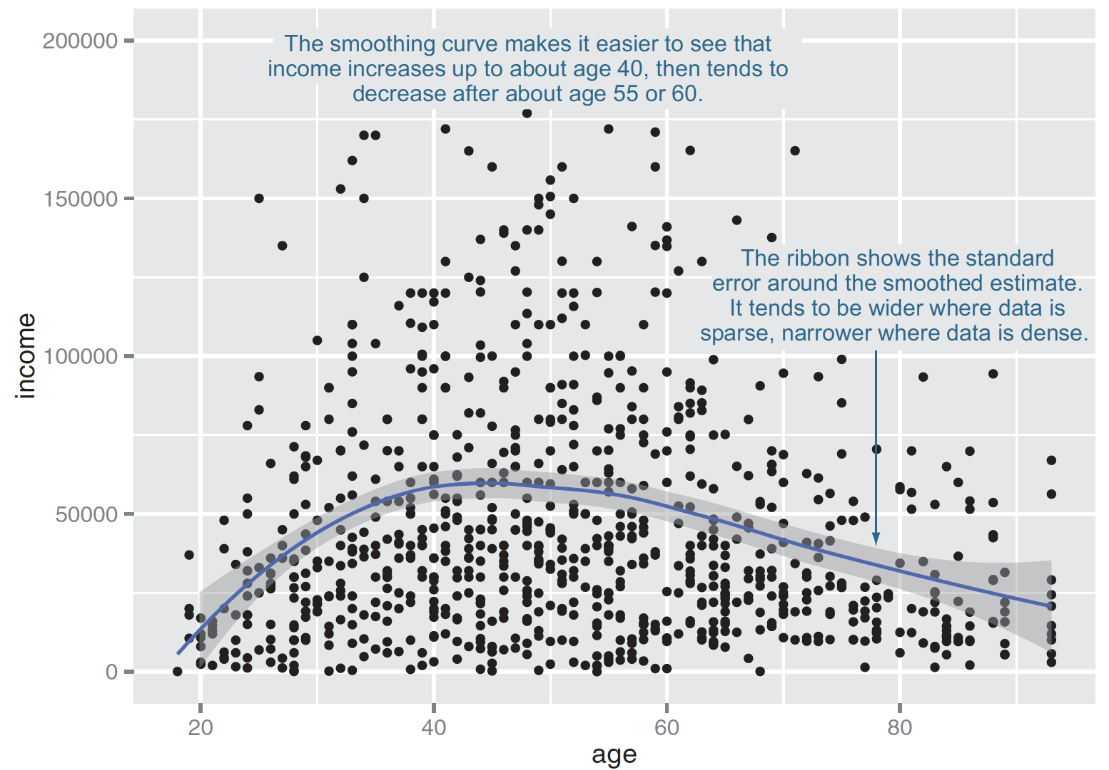
Smoothing curve
fit using the loess (or lowess ) functions, which calculate smoothed local linear fits of the data.
ggplot(custdata2, aes(x=age, y=income)) + geom_point() + geom_smooth() + ylim(0, 200000)
Figure3.11, Practical Data Science with R by Nina Zumel, John Mount

Slide 55
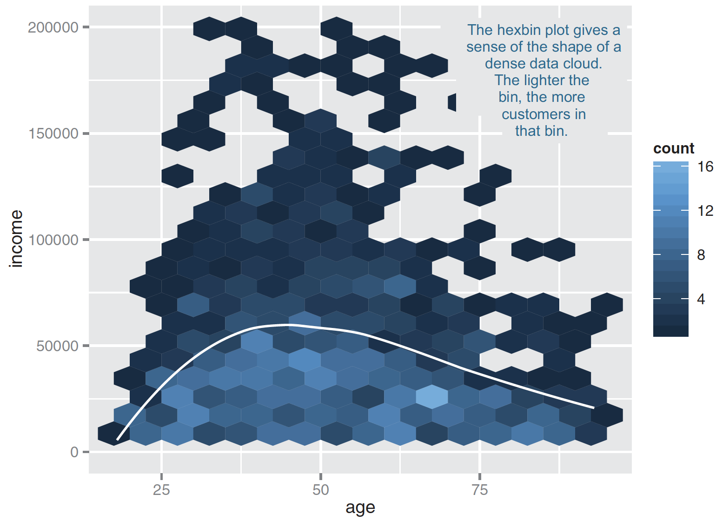
High-volume situations => HEXBIN PLOTS
library(hexbin)
ggplot(custdata2, aes(x=age, y=income)) +
geom_hex(binwidth=c(5, 10000)) +
geom_smooth(color="white", se=F) + ylim(0,200000)
Figure3.14, Practical Data Science with R by Nina Zumel, John Mount

Slide 56
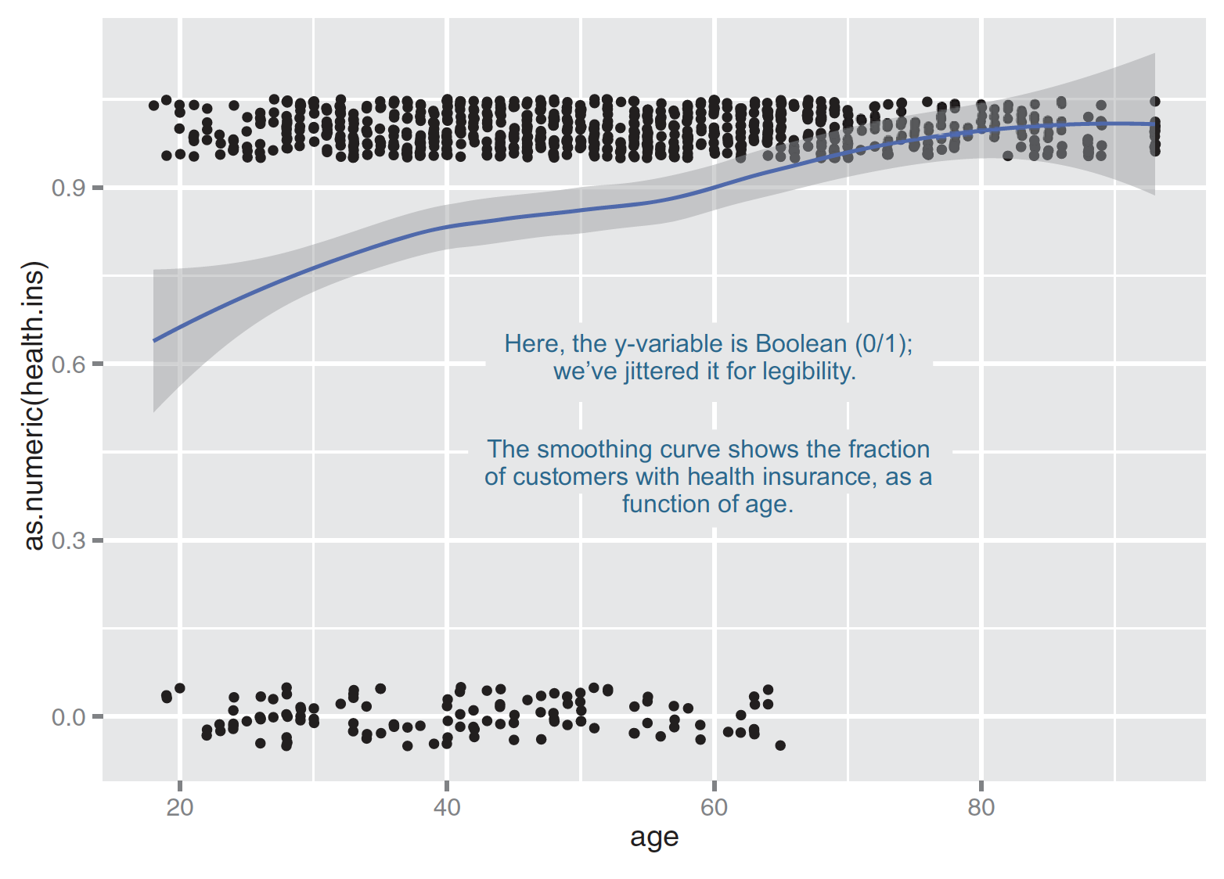
Smoothing curve for boolean variables
ggplot(custdata2, aes(x=age, y=as.numeric(health.ins))) + geom_point(position=position_jitter(w=0.05, h=0.05)) + geom_smooth()
Figure3.13 ,Practical Data Science with R by Nina Zumel, John Mount

Slide 57
Bar chart
Two categorical variables

Slide 58
Two categorical variables
twoVariable.R
Relation between cut & color
By count
ggplot(data = diamonds) + geom_count(mapping = aes(x = cut, y = color))
By heatmap
diamonds %>% count(color, cut) %>% ggplot(mapping = aes(x = color, y = cut)) + geom_tile(mapping = aes(fill = n))
R for Data Science by Garrett Grolemund, Hadley Wickham

Slide 59
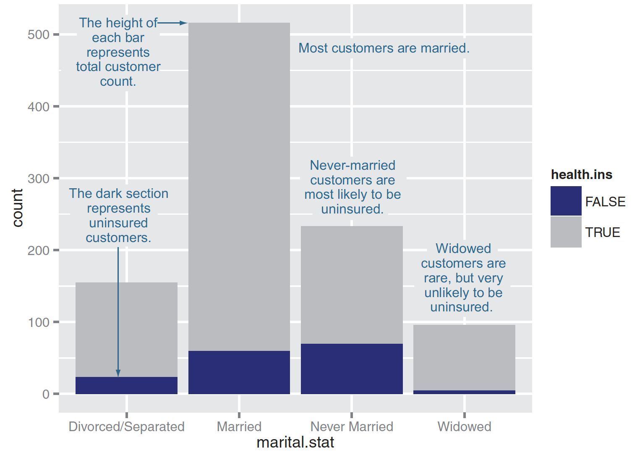
Stacked bar chart for two categorical variables
ggplot(custdata) + geom_bar(aes(x=marital.stat,
fill=health.ins))
Figure3.15, Practical Data Science with R by Nina Zumel, John Mount

Slide 60
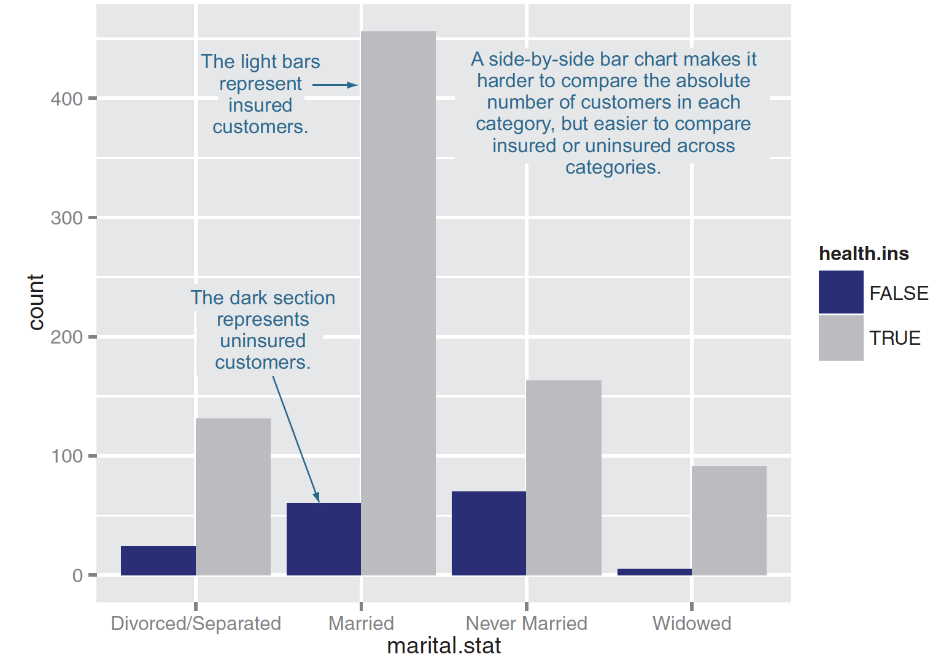
Side-by-side bar chart
ggplot(custdata) + geom_bar(aes(x=marital.stat,
fill=health.ins),
position="dodge")
Figure3.16, Practical Data Science with R by Nina Zumel, John Mount

Slide 61
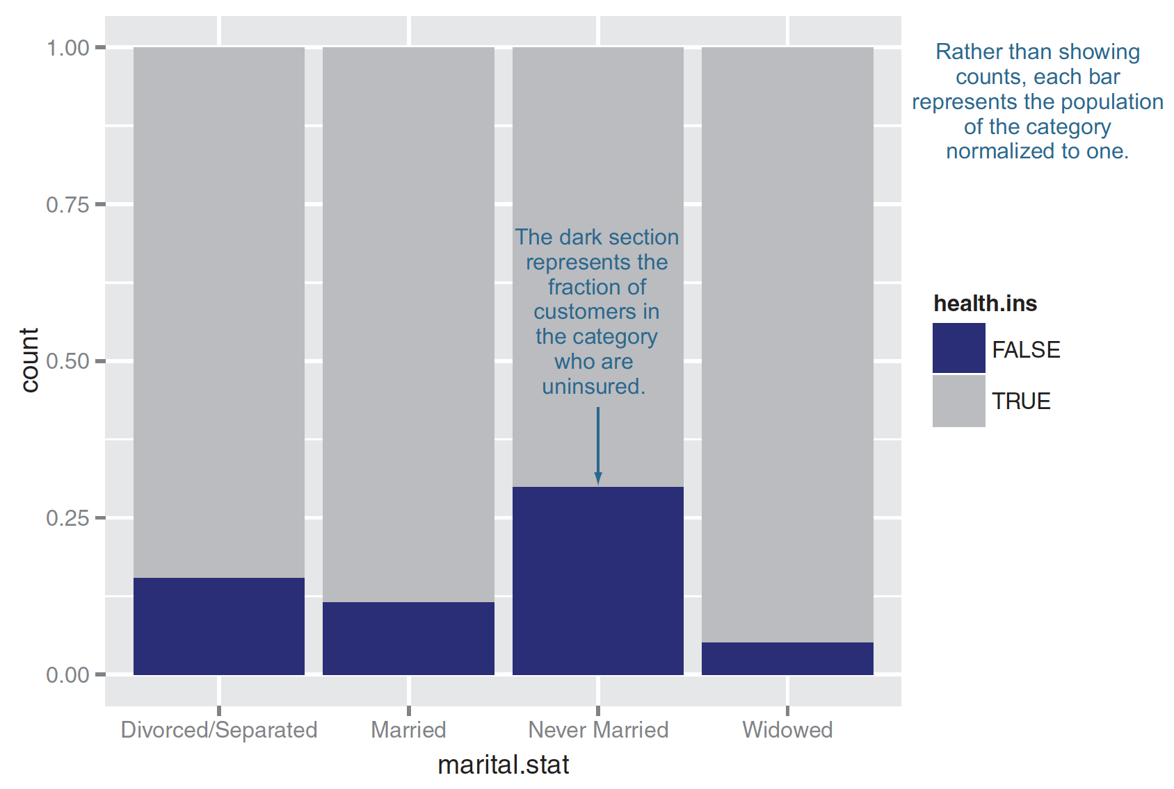
Filled bar chart
ggplot(custdata) + geom_bar(aes(x=marital.stat,
fill=health.ins),
position="fill")
Figure3.17, Practical Data Science with R by Nina Zumel, John Mount

Slide 62
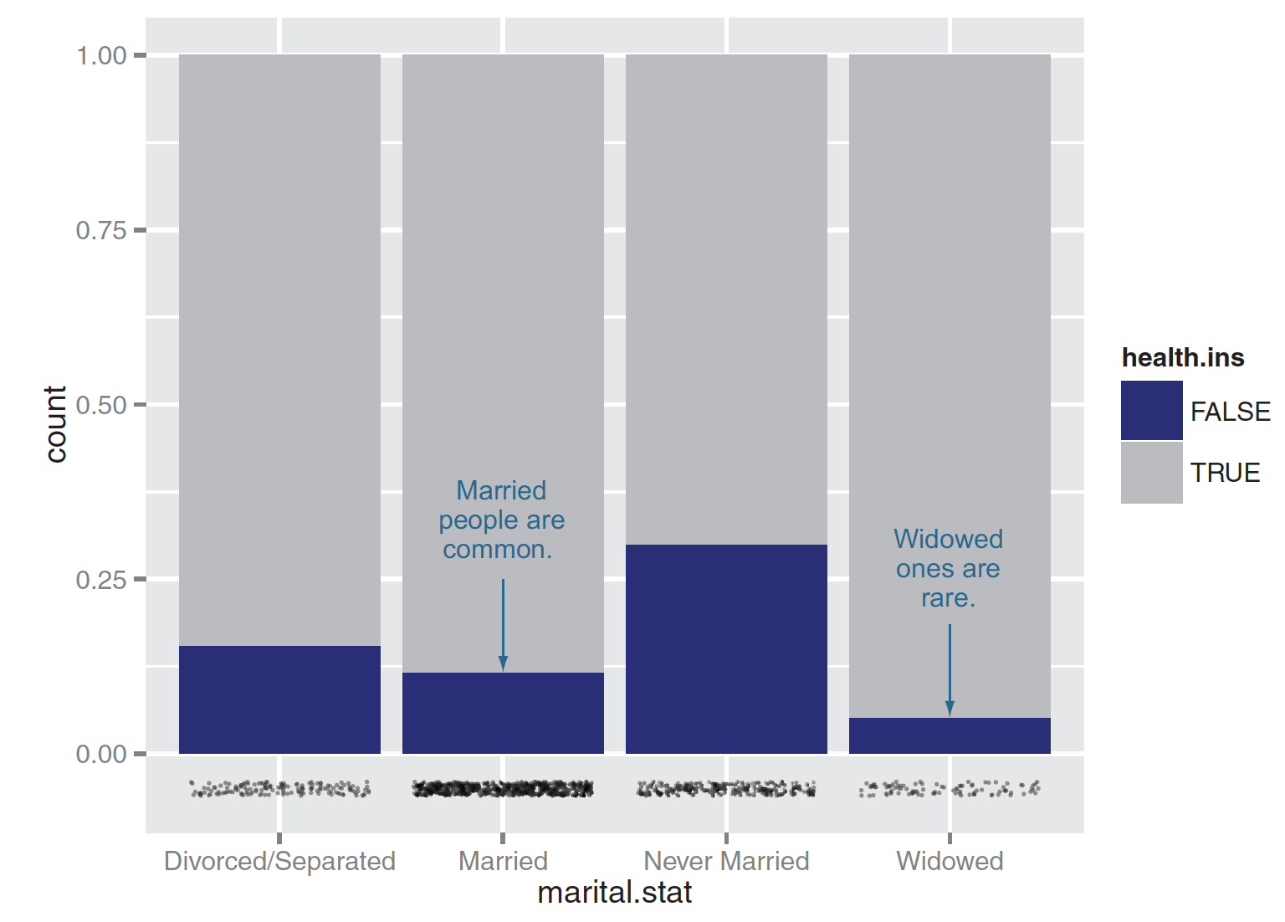
Plotting data with a rug
ggplot(custdata, aes(x=marital.stat)) +
geom_bar(aes(fill=health.ins), position="fill") +
geom_point(aes(y=-0.05), size=0.75, alpha=0.3,
position=position_jitter(h=0.01))
Figure3.18, Practical Data Science with R by Nina Zumel, John Mount

Slide 63
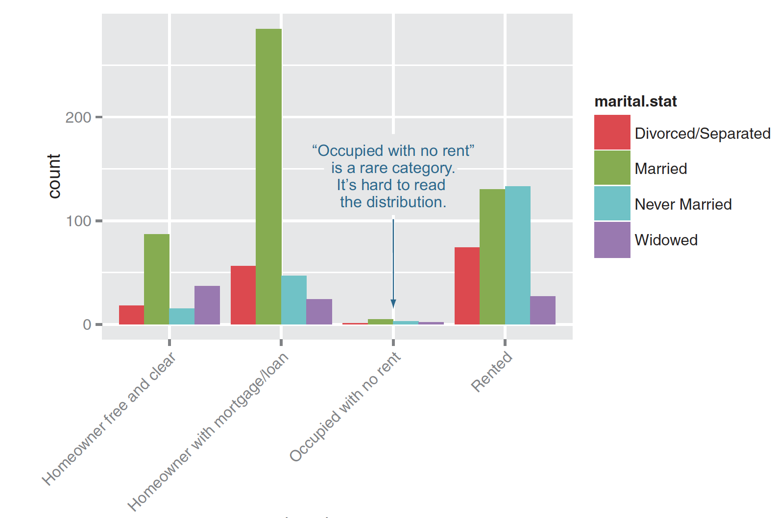
Plotting a bar chart without facets
ggplot(custdata2)+
geom_bar(aes(x=housing.type, fill=marital.stat ), position="dodge")+
theme(axis.text.x = element_text(angle = 45, hjust = 1))
Figure3.19, Practical Data Science with R by Nina Zumel, John Mount

Slide 64
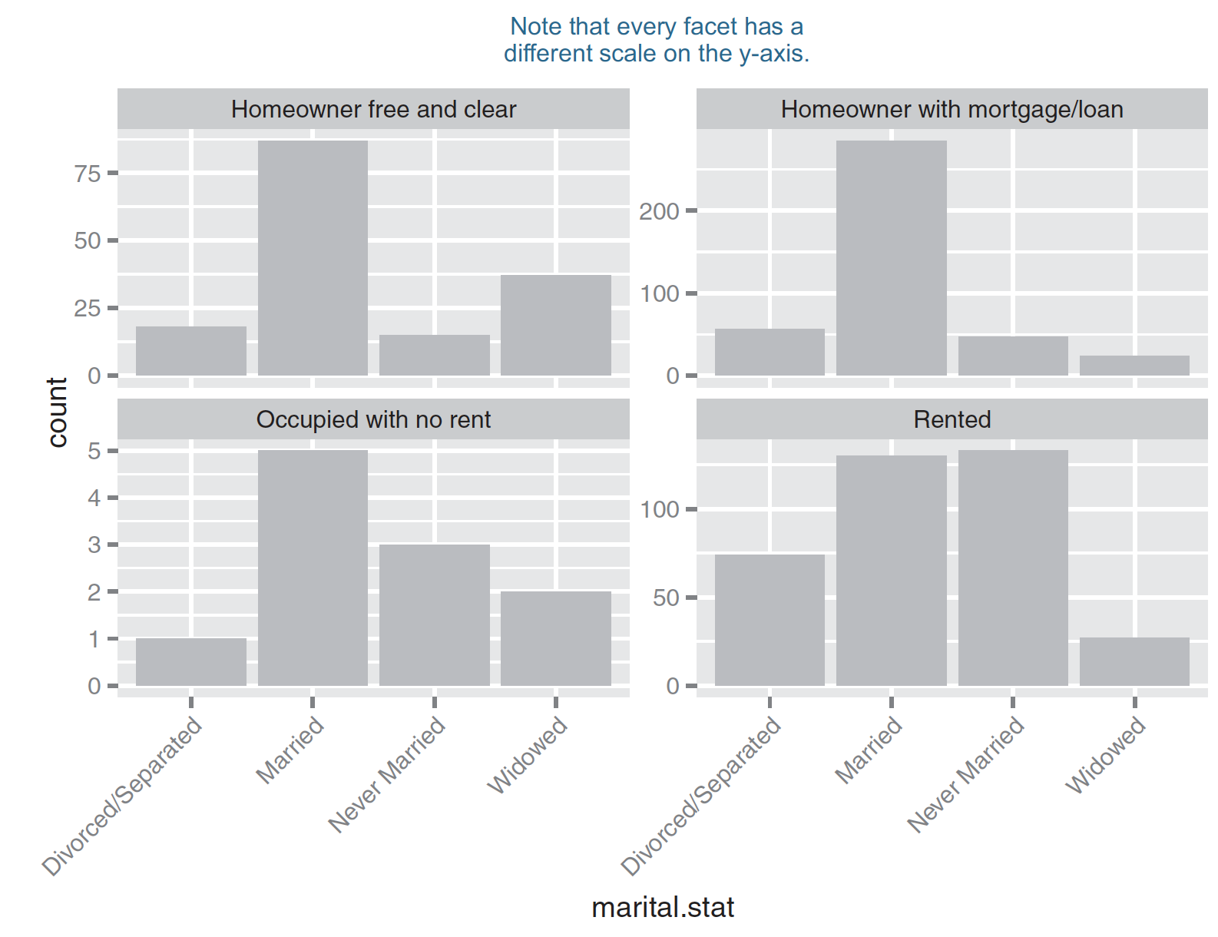
Plotting a bar chart with facets
ggplot(custdata2) + geom_bar(aes(x=marital.stat), position=“dodge”, fill=“darkgray”) + facet_wrap(~housing.type, scales="free_y") + theme(axis.text.x = element_text(angle = 45, hjust = 1))
Figure3.20, Practical Data Science with R by Nina Zumel, John Mount

Slide 65
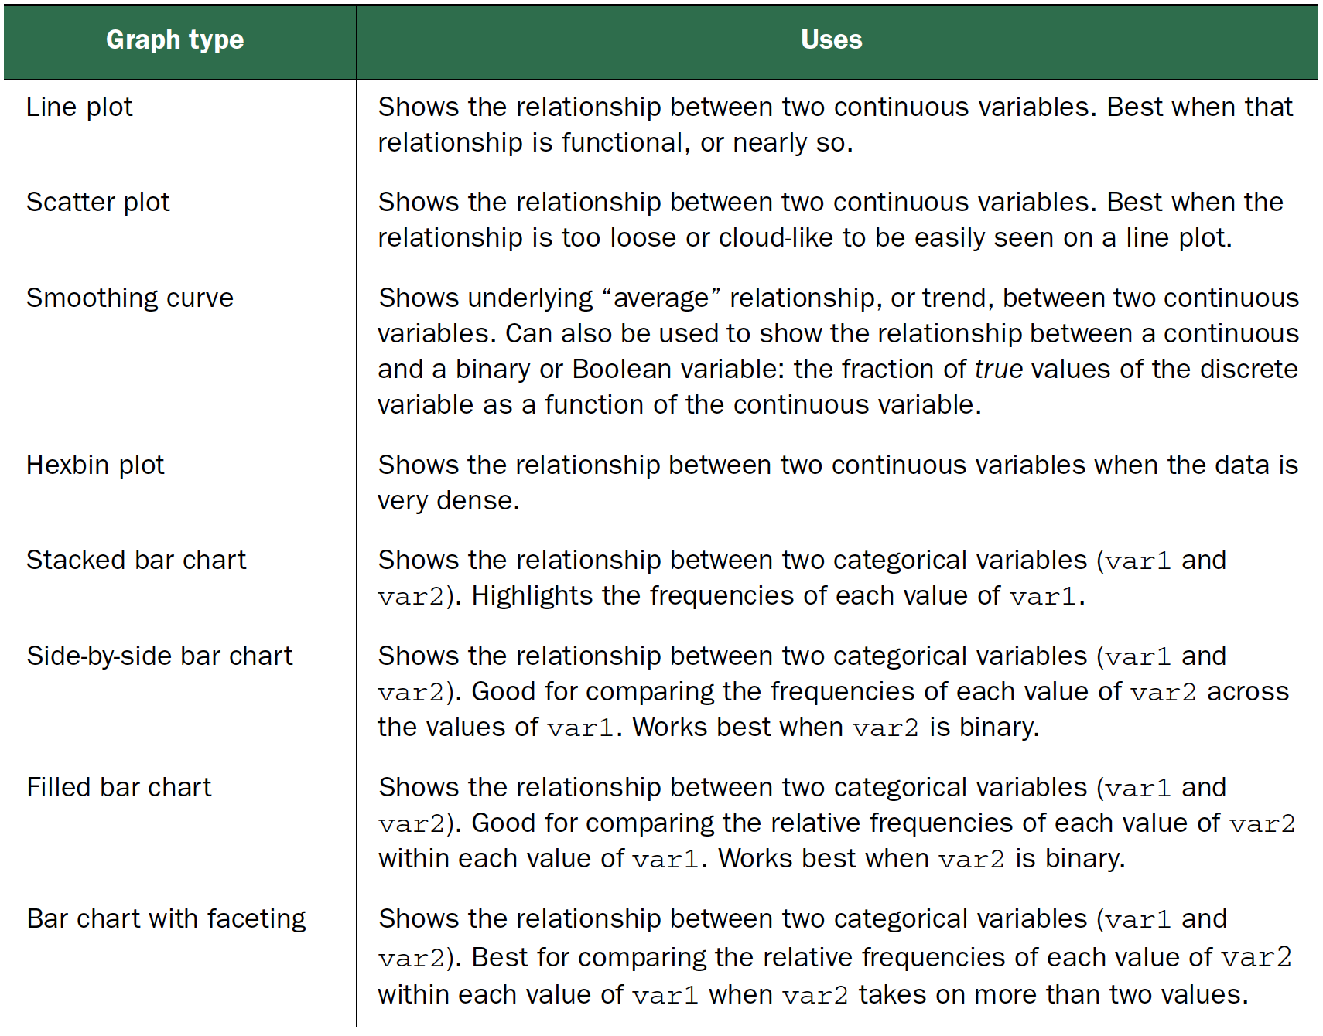
Visualizations for two variables
Practical Data Science with R by Nina Zumel, John Mount

Slide 66
Interactive visualization

Slide 67
ggvis
http://ggvis.rstudio.com/
interactive plots from the makers of ggplot2
a data visualization package for R which lets you:
Declaratively describe data graphics with a syntax similar in spirit to ggplot2.
Create rich interactive graphics that you can play with locally in Rstudio or in your browser.
Leverage shiny’s infrastructure to publish interactive graphics usable from any browser (either within your company or to the world).

Slide 68
ggvis
The goal is to combine
the best of R (e.g. every modelling function you can imagine)
the best of the web (everyone has a web browser).
Data manipulation and transformation are done in R, and the graphics are rendered in a web browser, using Vega.
For RStudio users, ggvis graphics display in a viewer panel, which is possible because RStudio is a web browser.

Slide 69
Install necessary packages & Load packages
ggvis.R
## Install necessary packages
install.packages("devtools")
library("devtools")
install.packages("ggvis")
# Load packages
library("ggvis")
library(ggplot2)
library(dplyr)
Credit by Juuso Parkkinen, http://ouzor.github.io/blog/2014/11/21/interactive-visualizations.html

Slide 70
Prepare data
# Define image sizes
img.width <- 450
img.height <- 300
# Use mtcars data data(mtcars)
mtcars$cyl <- factor(mtcars$cyl)
mtcars$am <- factor(mtcars$am)
# Compute mean mpg per cyl and am, by library("dplyr")
mtcars.mean <- mtcars %>% dplyr::group_by(cyl, am) %>%
dplyr::summarise(mpg_mean=mean(mpg)) %>%
dplyr::select(cyl, am, mpg_mean) %>% ungroup()
Credit by Juuso Parkkinen, http://ouzor.github.io/blog/2014/11/21/interactive-visualizations.html

Slide 71
Histograms
ggplot
hist.ggplot <- ggplot(mtcars, aes(x=mpg)) + geom_histogram(binwidth=1)
hist.ggplot
ggvis
hist.ggvis <- mtcars %>% ggvis(x = ~mpg) %>% layer_histograms(width=1) %>% set_options(width = img.width, height = img.height)
hist.ggvis
Credit by Juuso Parkkinen, http://ouzor.github.io/blog/2014/11/21/interactive-visualizations.html

Slide 72
Why %>%?
ggvis uses the pipe operator %>% (familiar for dplyr users), replacing the + in ggplot2
# convert engine displacment to litres
mtcars %>%
ggvis(x = ~mpg, y = ~disp) %>%
layer_points()
Credit by http://ggvis.rstudio.com/ggvis-basics.html
Notes:
mtcars %>%
ggvis(x = ~mpg, y = ~disp) %>%
mutate(disp = disp / 61.0237) %>% layer_points()

Slide 73
Scatter plots
ggplot
scatter.ggplot <- ggplot(mtcars, aes(x=wt, y=mpg)) + geom_point()
scatter.ggplot
ggvis
scatter.ggvis <- mtcars %>% ggvis(x = ~wt, y = ~mpg) %>% layer_points() %>% set_options(width = img.width, height = img.height)
scatter.ggvis
mtcars %>% ggvis(~wt, ~mpg) %>% layer_points() %>% layer_model_predictions(model = "lm", se = TRUE)
Credit by Juuso Parkkinen, http://ouzor.github.io/blog/2014/11/21/interactive-visualizations.html

Slide 74
ggvis
p <- ggvis(mtcars, x = ~wt, y = ~mpg)
layer_points(p)
=>
layer_points(ggvis(mtcars, x = ~wt, y = ~mpg))
=>
mtcars %>% ggvis(x = ~wt, y = ~mpg) %>% layer_points()
Credit by http://ggvis.rstudio.com/ggvis-basics.html

Slide 75
Scatter plots by group
ggplot
scatter.ggplot <- ggplot(mtcars, aes(x=wt, y=mpg, colour=cyl)) + geom_point()
scatter.ggplot
Credit by Juuso Parkkinen, http://ouzor.github.io/blog/2014/11/21/interactive-visualizations.html

Slide 76
Scatter plots by group
ggvis
scatter.ggvis <- mtcars %>% ggvis(x = ~wt, y = ~mpg, fill = ~cyl) %>% layer_points() %>% set_options(width = img.width, height = img.height)
scatter.ggvis
mtcars %>%
ggvis(~wt, ~mpg, fill = ~factor(cyl)) %>%
layer_points() %>%
group_by(cyl) %>%
layer_model_predictions(model = "lm", se = TRUE)
Credit by Juuso Parkkinen, http://ouzor.github.io/blog/2014/11/21/interactive-visualizations.html

Slide 77
Line plots
ggplot
line.ggplot <- ggplot(mtcars.mean, aes(x=cyl, y=mpg_mean, colour=am)) + geom_line(aes(group=am))
line.ggplot
ggvis
line.ggvis <- mtcars.mean %>% ggvis(x = ~cyl, y = ~mpg_mean, stroke = ~am) %>% layer_lines() %>% set_options(width = img.width, height = img.height)
line.ggvis
Credit by Juuso Parkkinen, http://ouzor.github.io/blog/2014/11/21/interactive-visualizations.html

Slide 78
Layers
Simple, which include primitives like points, lines and rectangles.
mtcars %>% ggvis(~wt, ~mpg) %>% layer_points()
Compound, which combine data transformations with one or more simple layers.
mtcars %>% ggvis(~mpg) %>% layer_histograms()
Multiple layers
mtcars %>% ggvis(~wt, ~mpg) %>% layer_points() %>% layer_smooths()
Credit by http://ggvis.rstudio.com/ggvis-basics.html

Slide 79
Interaction: input_*
input_checkbox(): a check-box
input_checkboxgroup(): a group of check boxes
input_numeric(): a spin box
input_radiobuttons(): pick one from a set options
input_select(): create a drop-down text box
input_text(): arbitrary text input
Credit by hhttp://ggvis.rstudio.com/interactivity.html

Slide 80
density plot
hist.ggplot <- ggplot(mtcars, aes(x=wt)) + geom_histogram(binwidth=0.3455)
plot(density(mtcars$wt))
The (S3) generic function density computes kernel density estimates. Its default method does so with the given kernel and bandwidth for univariate observations.
Kernel
bandwidth
Credit by hhttp://ggvis.rstudio.com/interactivity.html

Slide 81
Density plot with input_slider + check box
mtcars %>% ggvis(x = ~wt) %>%
layer_densities( adjust = input_slider(.1, 2, value = 1, step = .1, label = "Bandwidth adjustment"),
kernel = input_select( c("Gaussian" = "gaussian", "Epanechnikov" = "epanechnikov", "Rectangular" = "rectangular", "Triangular" = "triangular", "Biweight" = "biweight", "Cosine" = "cosine", "Optcosine" = "optcosine"), label = "Kernel") )
Credit by hhttp://ggvis.rstudio.com/interactivity.html

Slide 82
Interaction
mtcars %>% ggvis(~mpg, ~disp, size = ~vs) %>% layer_points()
mtcars %>% ggvis(~wt, ~mpg, size := 300, opacity := 0.4) %>% layer_points()
=>
mtcars %>% ggvis(~wt, ~mpg, size := input_slider(10, 100), opacity := input_slider(0, 1) ) %>% layer_points()
=>
slider <- input_slider(10, 1000)
mtcars %>% ggvis(~wt, ~mpg) %>% layer_points(fill := "red", opacity := 0.5, size := slider)
Credit by http://ggvis.rstudio.com/ggvis-basics.html

Slide 83
Shiny app

Slide 84

Shiny
an R package that makes it easy to build interactive web applications (apps) straight from R.
http://shiny.rstudio.com/

Slide 85
Shiny
helloShiny.R
install.packages("shiny")
library(shiny)
runExample("01_hello") runExample("01_hello", display.mode = "showcase")
Shiny apps have two components:
a user-interface script
a server script

Slide 86
Running an App
helloWorld/app.R
Hello World
Change the title from “Hello Shiny!” to “Hello World!”.
Set the minimum value of the slider bar to 5.
Change the histogram color from " skyblue" to "darkgray".
Relaunching Apps
Credit by http://ggvis.rstudio.com/ggvis-basics.html

Slide 87
hello, world!
While small test programs have existed since the development of programmable computers, the tradition of using the phrase "Hello, world!" as a test message was influenced by an example program in the seminal book The C Programming Language. The example program from that book prints "hello, world" (without capital letters or exclamation mark), and was inherited from a 1974 Bell Laboratories internal memorandum by Brian Kernighan, Programming in C.A Tutorial.
Credit by https://en.wikipedia.org/wiki/%22Hello,_World!%22_program

Slide 88
The C Programming Language
sometimes termed K&R
computer programming book written by Brian Kernighan and Dennis Ritchie, the latter of whom originally designed and implemented the language.
The book was central to the development and popularization of the C programming language and is still widely read and used today.

Slide 89
Shiny examples
system.file("examples", package="shiny")
runExample("01_hello") # a histogram
runExample("02_text") # tables and data frames
runExample("03_reactivity") # a reactive expression
runExample("04_mpg") # global variables
runExample("05_sliders") # slider bars
runExample("06_tabsets") # tabbed panels
runExample("07_widgets") # help text and submit buttons
runExample("08_html") # Shiny app built from HTML
runExample("09_upload") # file upload wizard
runExample("10_download") # file download wizard
runExample("11_timer") # an automated timer
Credit by http://shiny.rstudio.com/tutorial/lesson1/

Slide 90
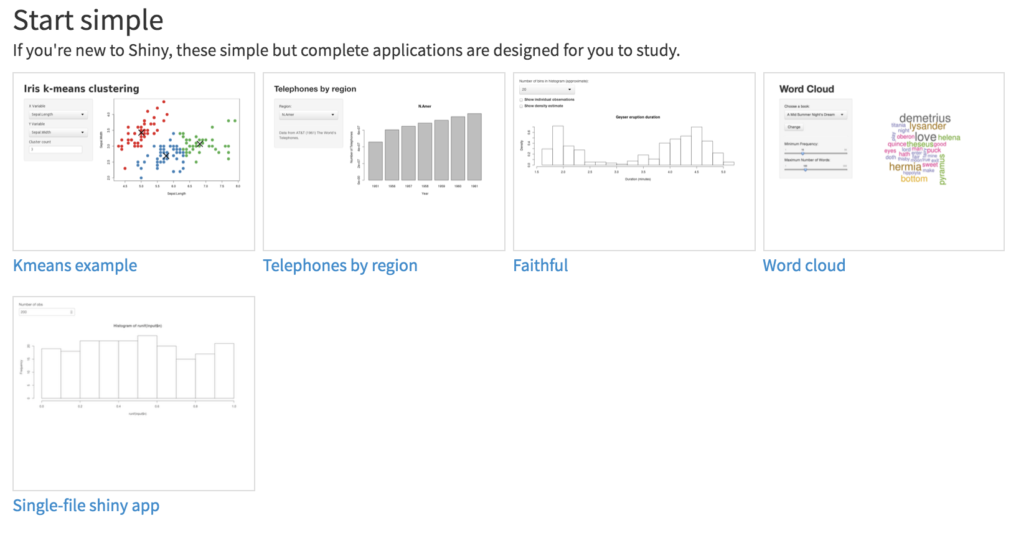
Shiny Gallery
http://shiny.rstudio.com/gallery

Slide 91
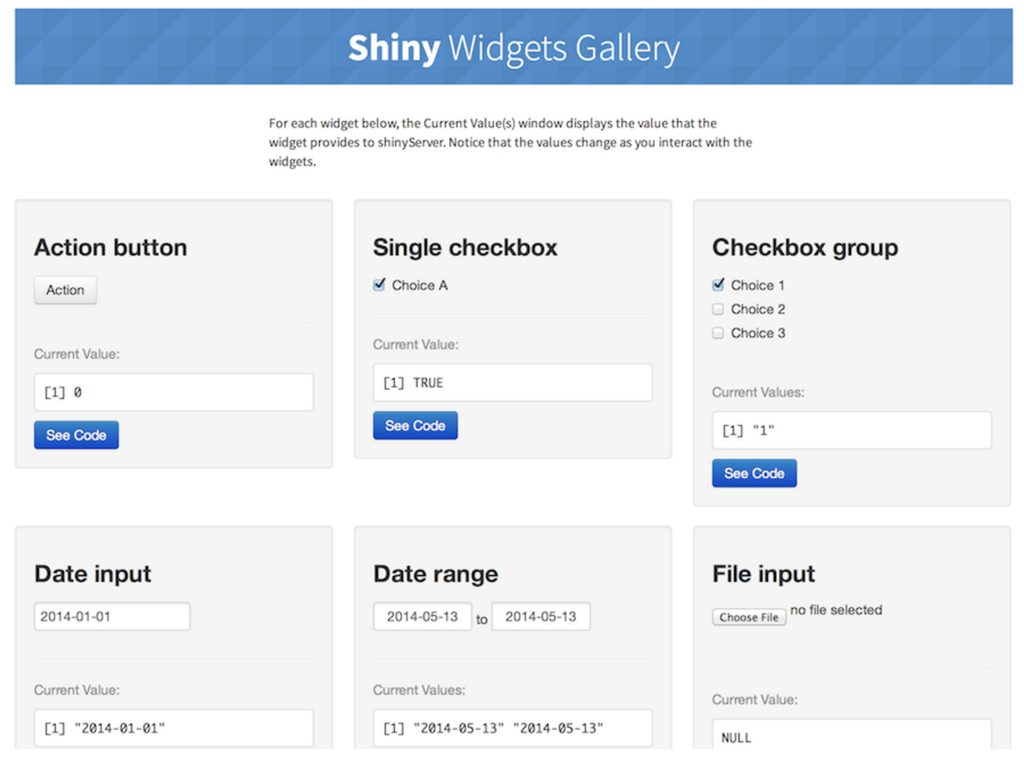
Shiny Widgets Gallery
http://shiny.rstudio.com/gallery/widget-gallery.html

Slide 92
Share your apps
Share your Shiny app as one file with two function
server
ui
Share your Shiny app as a web page.
Credit by http://shiny.rstudio.com/tutorial/

Slide 93
Share your Shiny app as two files
runUrl
runUrl(’url’)
runUrl('https://github.com/rstudio/shiny_example/archive/master.tar.gz')
runGitHub
runGitHub( "<your repository name>", "<your user name>")
runGitHub("shiny_example", "rstudio")
runGist
runGist("3239667")
Credit by http://shiny.rstudio.com/tutorial/

Slide 94
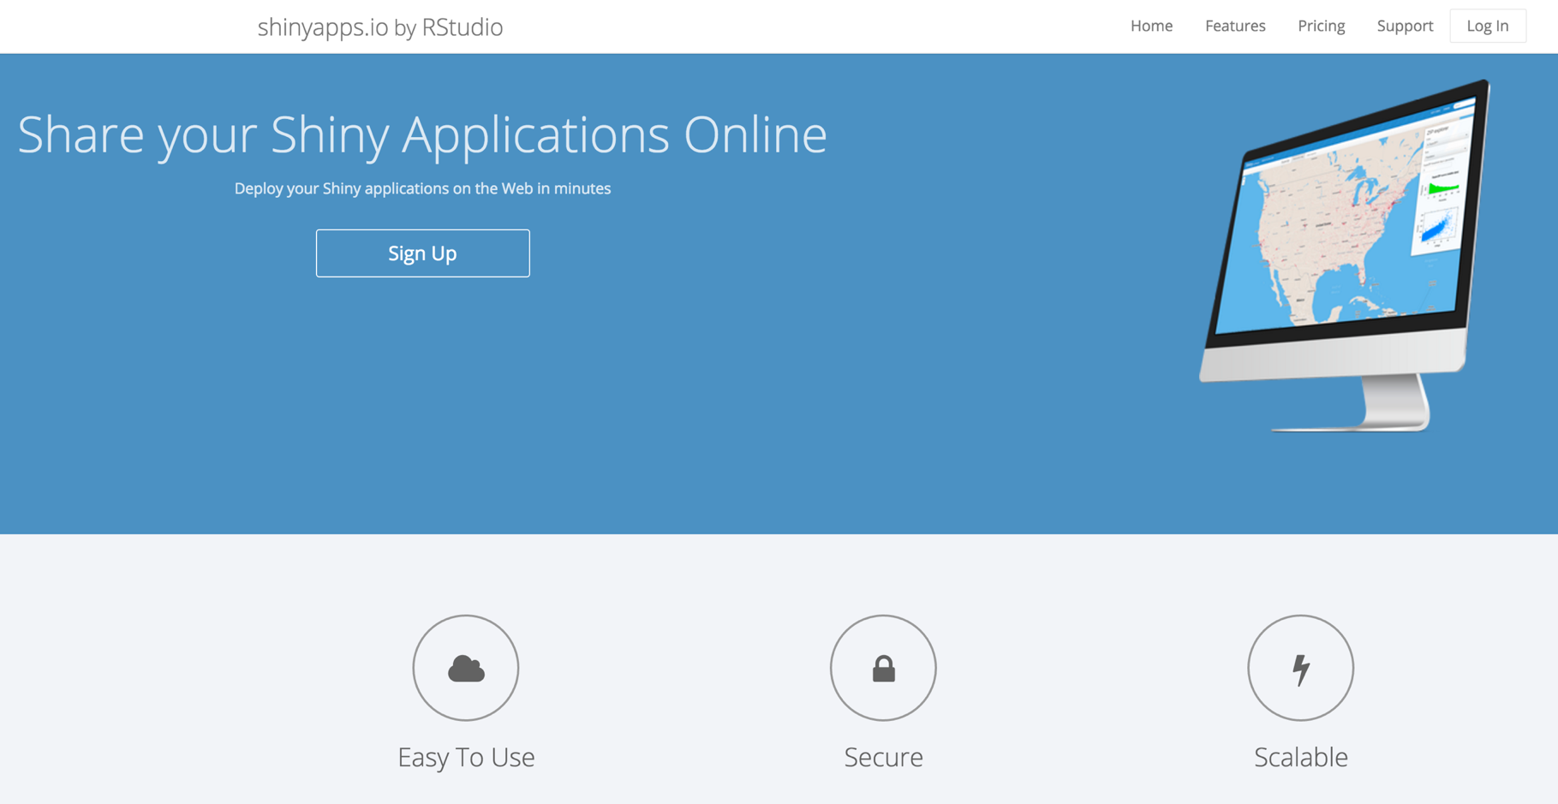
Share as a web page
Shinyapps.io

Slide 95
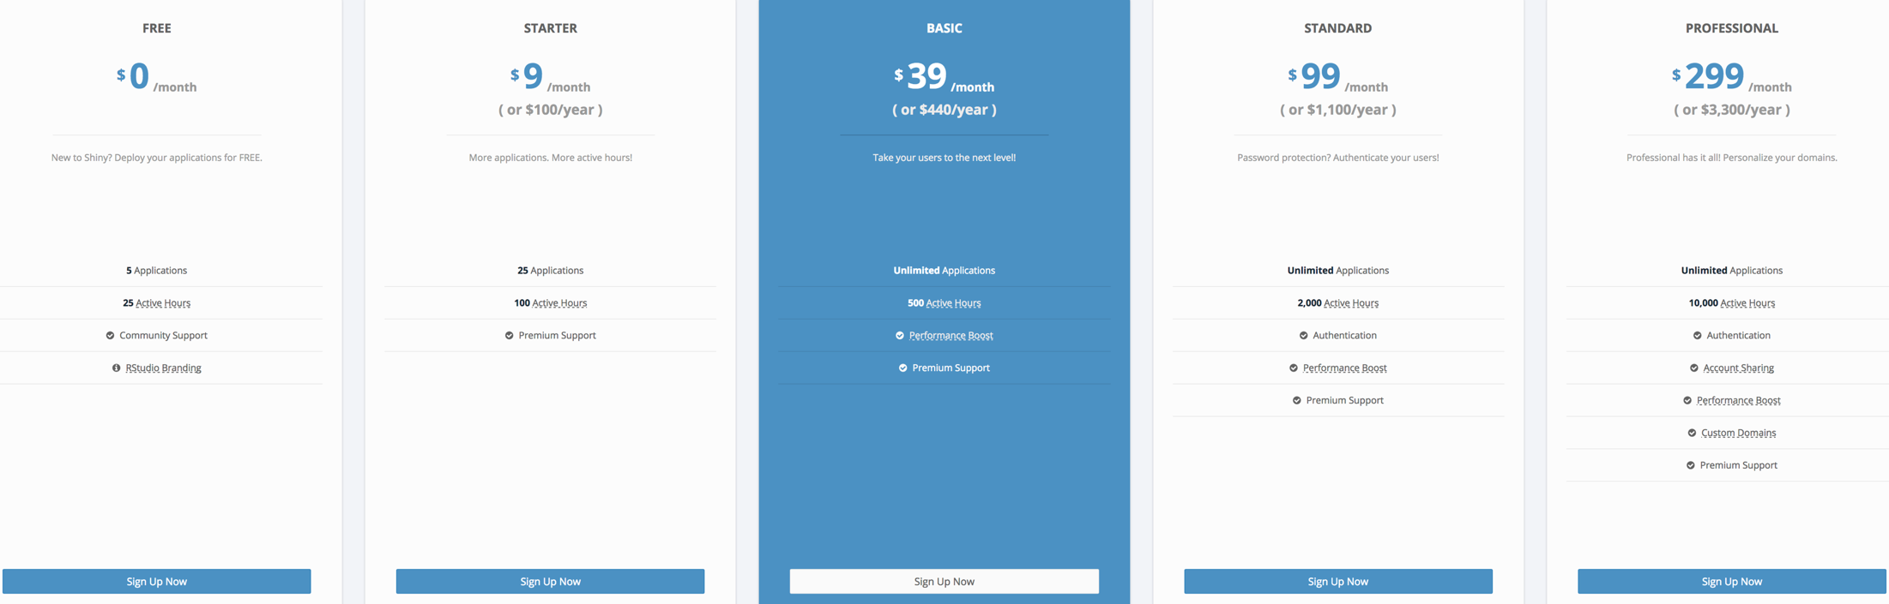
Share as a web page

Slide 96
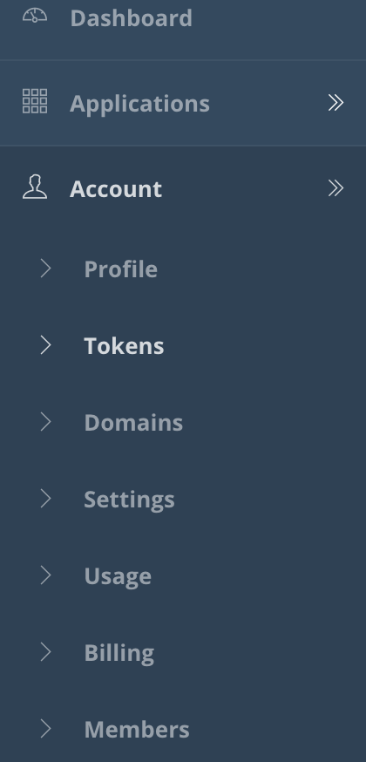
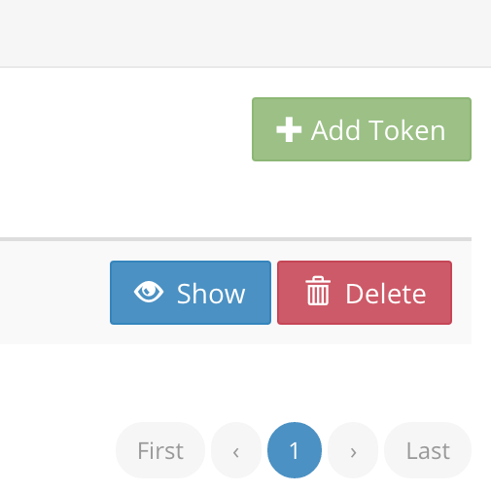

Registration

Slide 97
Share by Shinyapps.io
STEP 1 – INSTALL RSCONNECT
install.packages('rsconnect')
STEP 2 – AUTHORIZE ACCOUNT
rsconnect::setAccountInfo(name=‘jmchang', token=’***', secret=’***')
STEP 3 – DEPLOY
library(rsconnect)
rsconnect::deployApp('path/to/your/app')

Slide 98
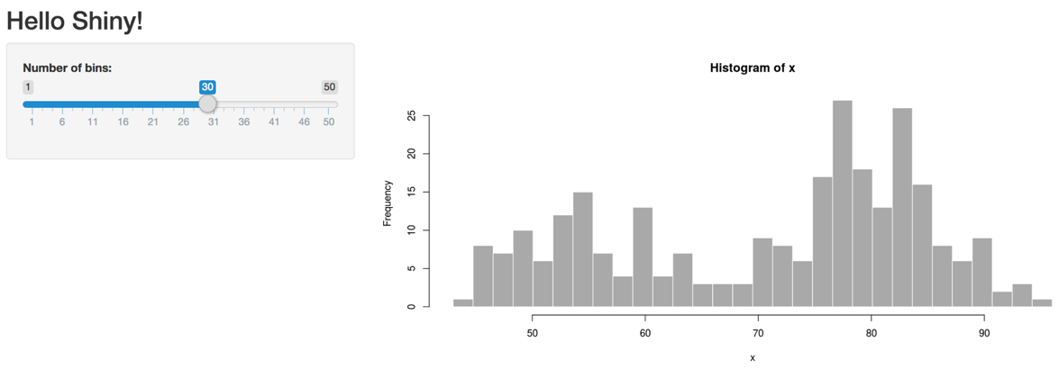
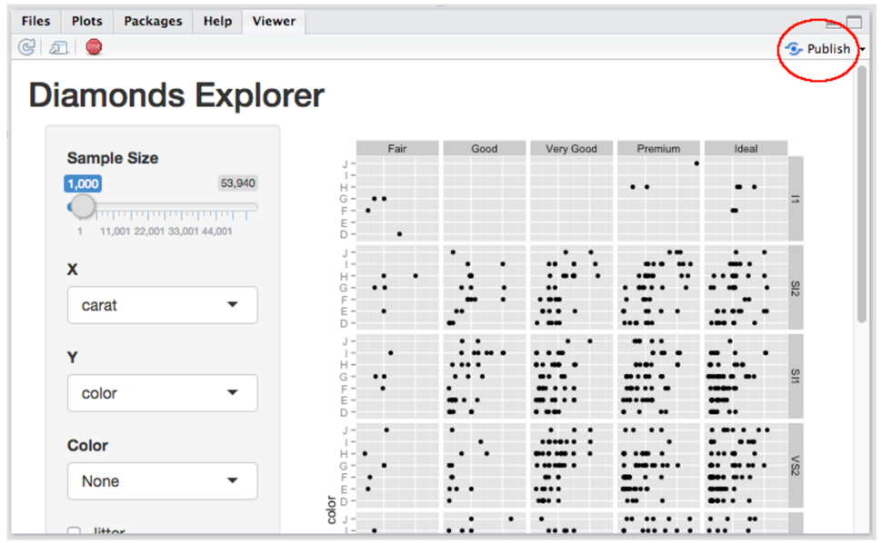
Share by Shinyapps.io
https://changlab.shinyapps.io/app1/

Slide 99
References
ggplot2: Elegant Graphics for Data Analysis (3e)
https://ggplot2-book.org/
R Graphics Cookbook by Winston Chang
Online http://www.cookbook-r.com/Graphs/
Graphical Data Analysis with R by Antony Unwin

Slide 100

Quick-R
http://www.statmethods.net/

Slide 101
2017 台灣資料科學年會
Big Data Visualization 馬匡六, University of California at Davis Professor
重新認識資料視覺化 王昱舜, 交通大學資訊工程系副教授

Slide 102


Thank You Any Question?

